Slide 1

Optimization of water-table monitoring networks in the eastern Snake River Plain aquifer using a kriging-based genetic algorithm methodology
Jason C. Fisher
U.S. Department of the Interior
U.S. Geological Survey
Notes:
The purpose of this work is to reduce the operating costs of a existing water-table monitoring network.
Identify wells that can be removed form the existing network because they provide little or no beneficial added information.
Cooperators include the U.S. Bureau of Reclamation, Department of Energy, and the USGS Office of Groundwater.

Slide 2
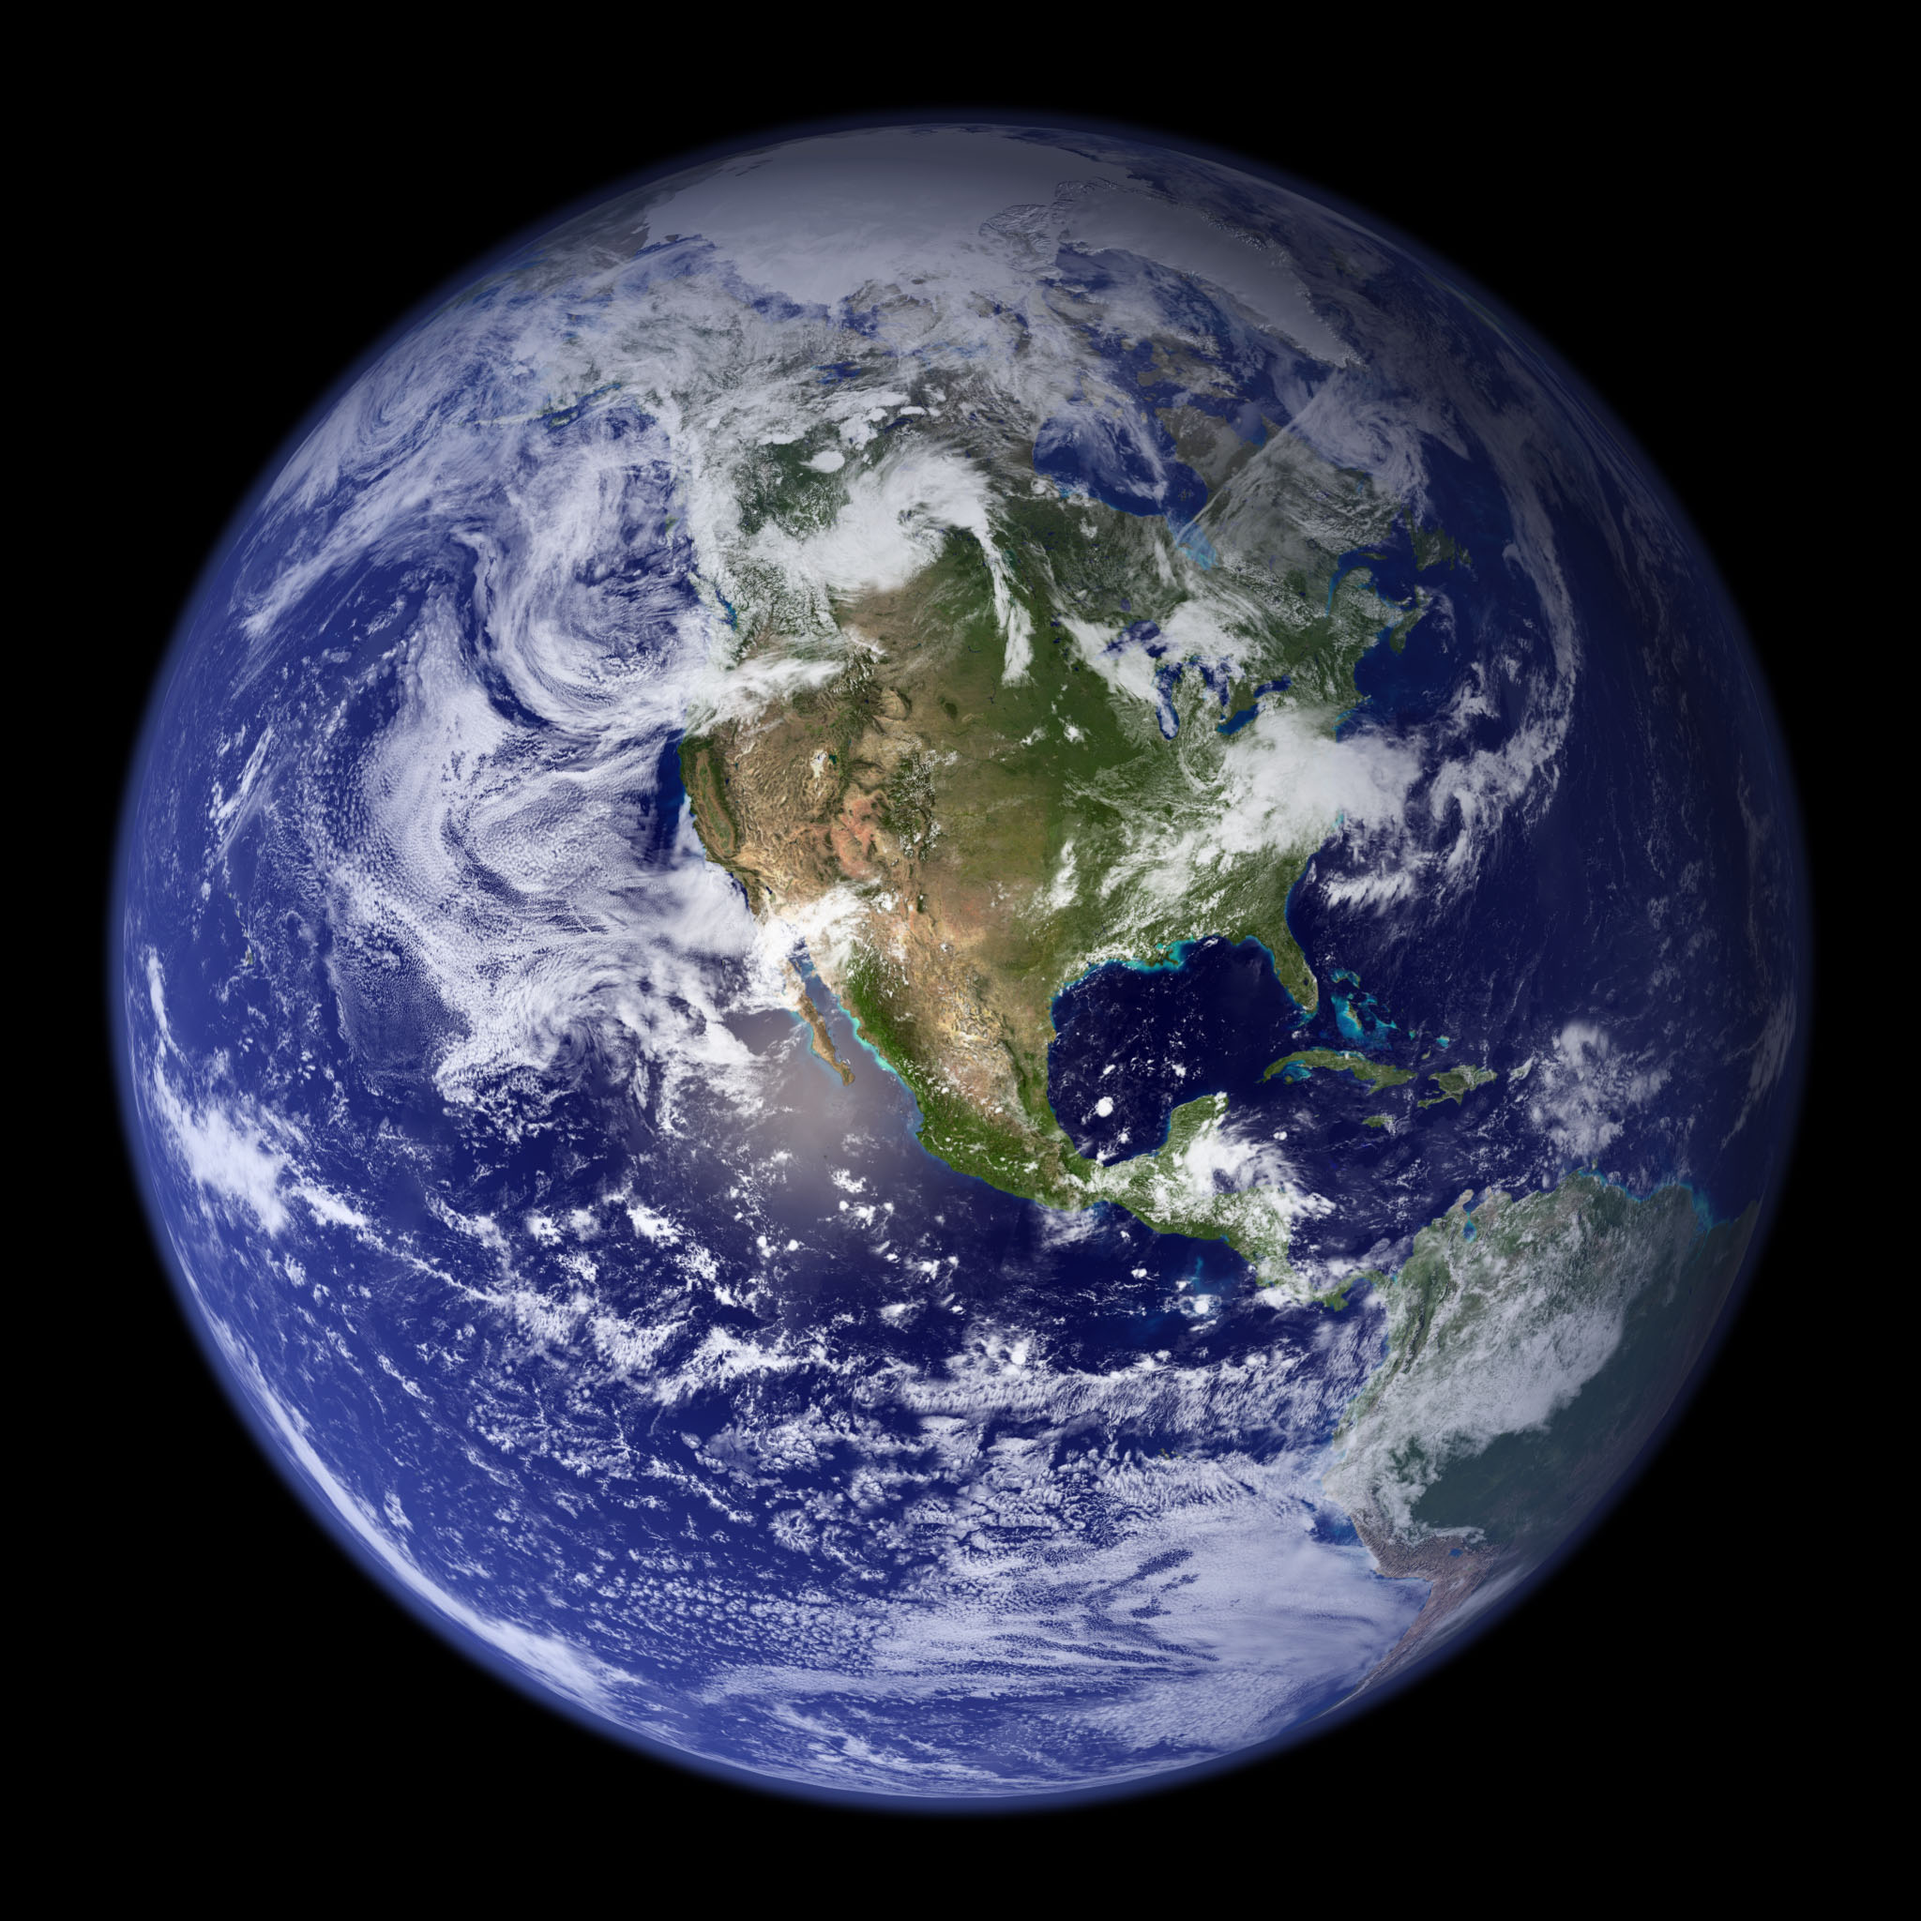

Slide 3
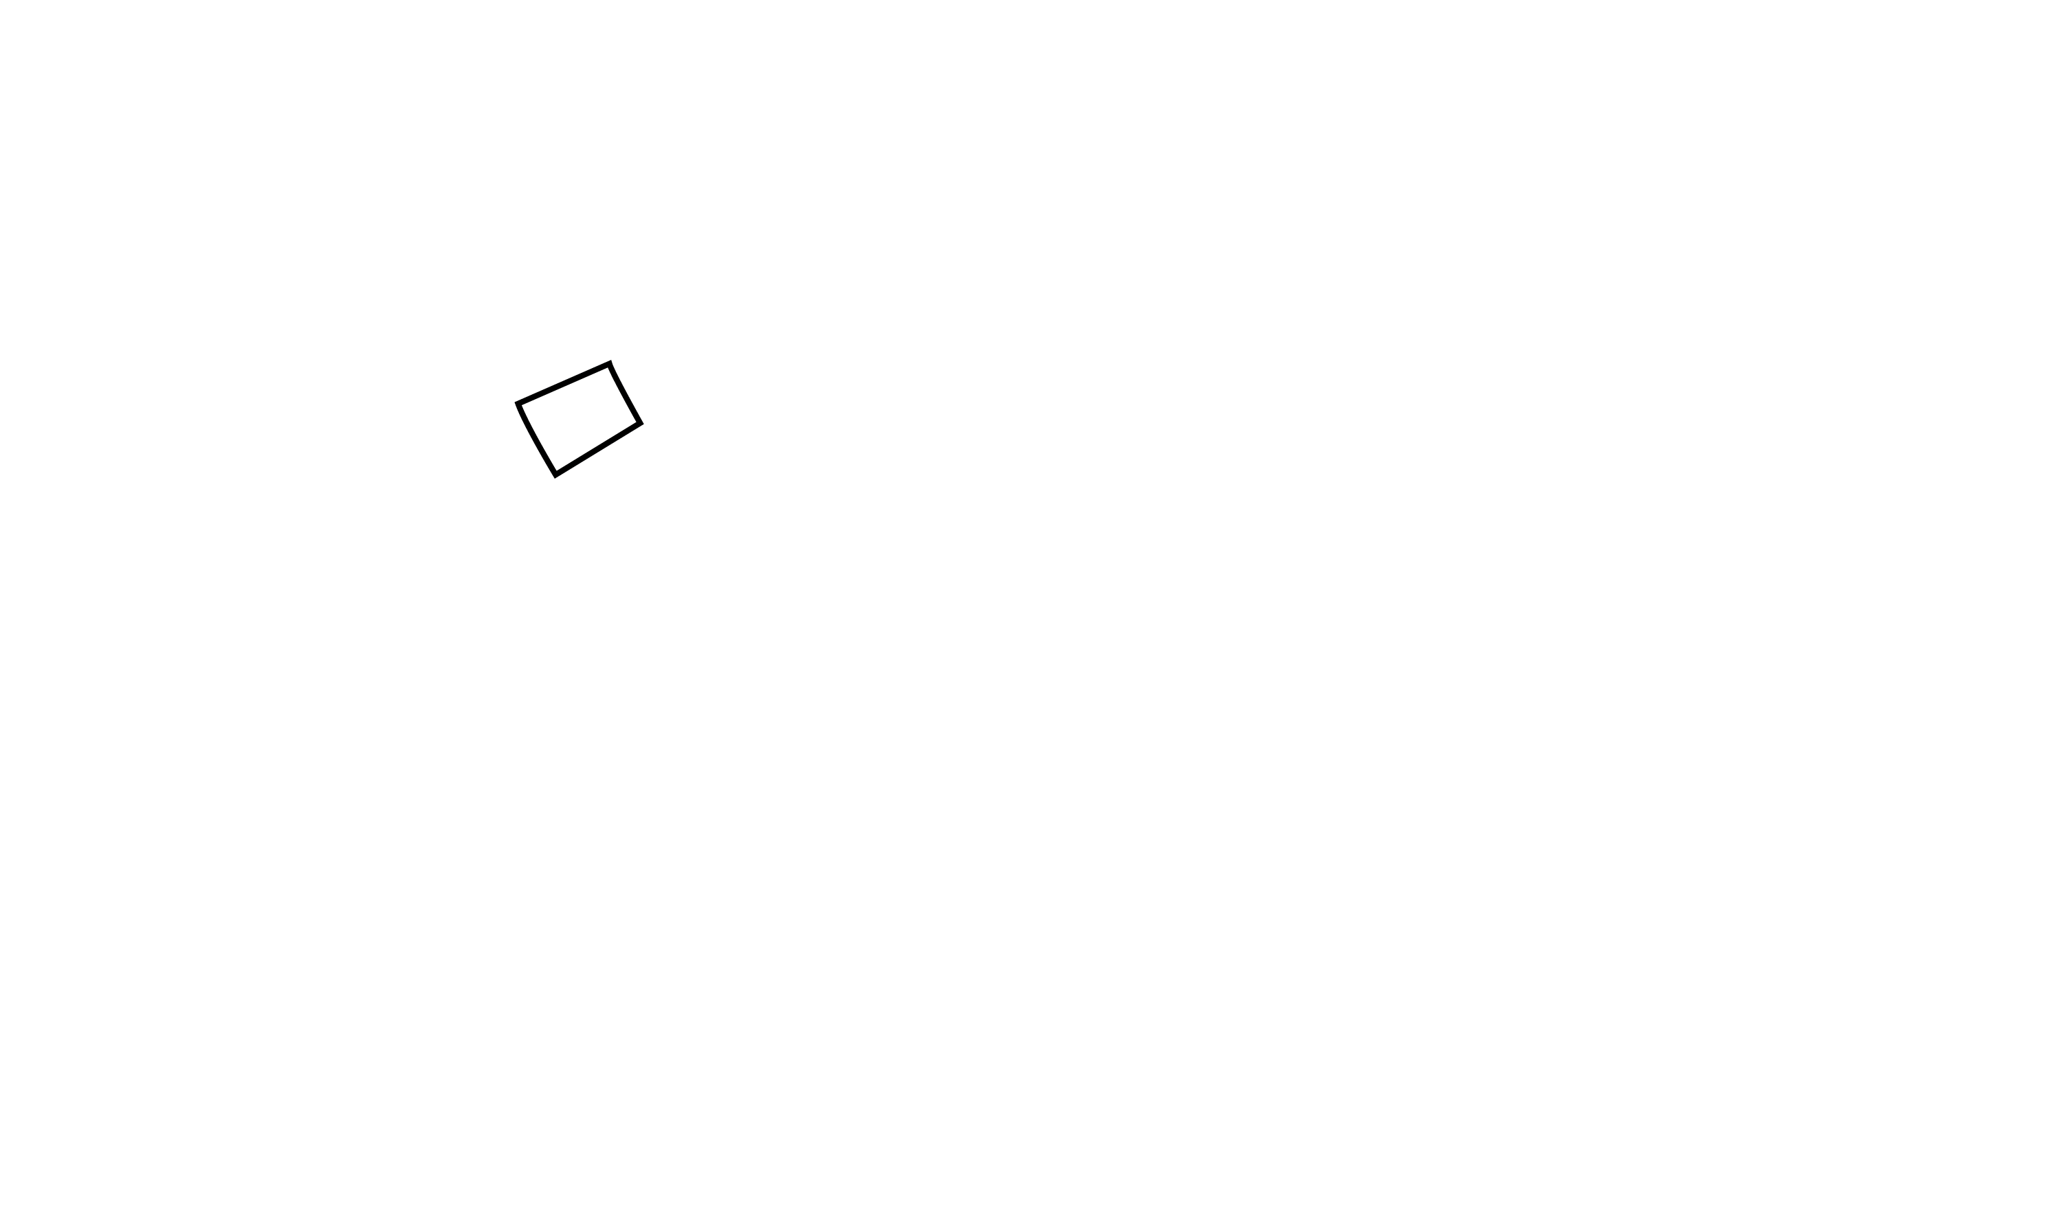
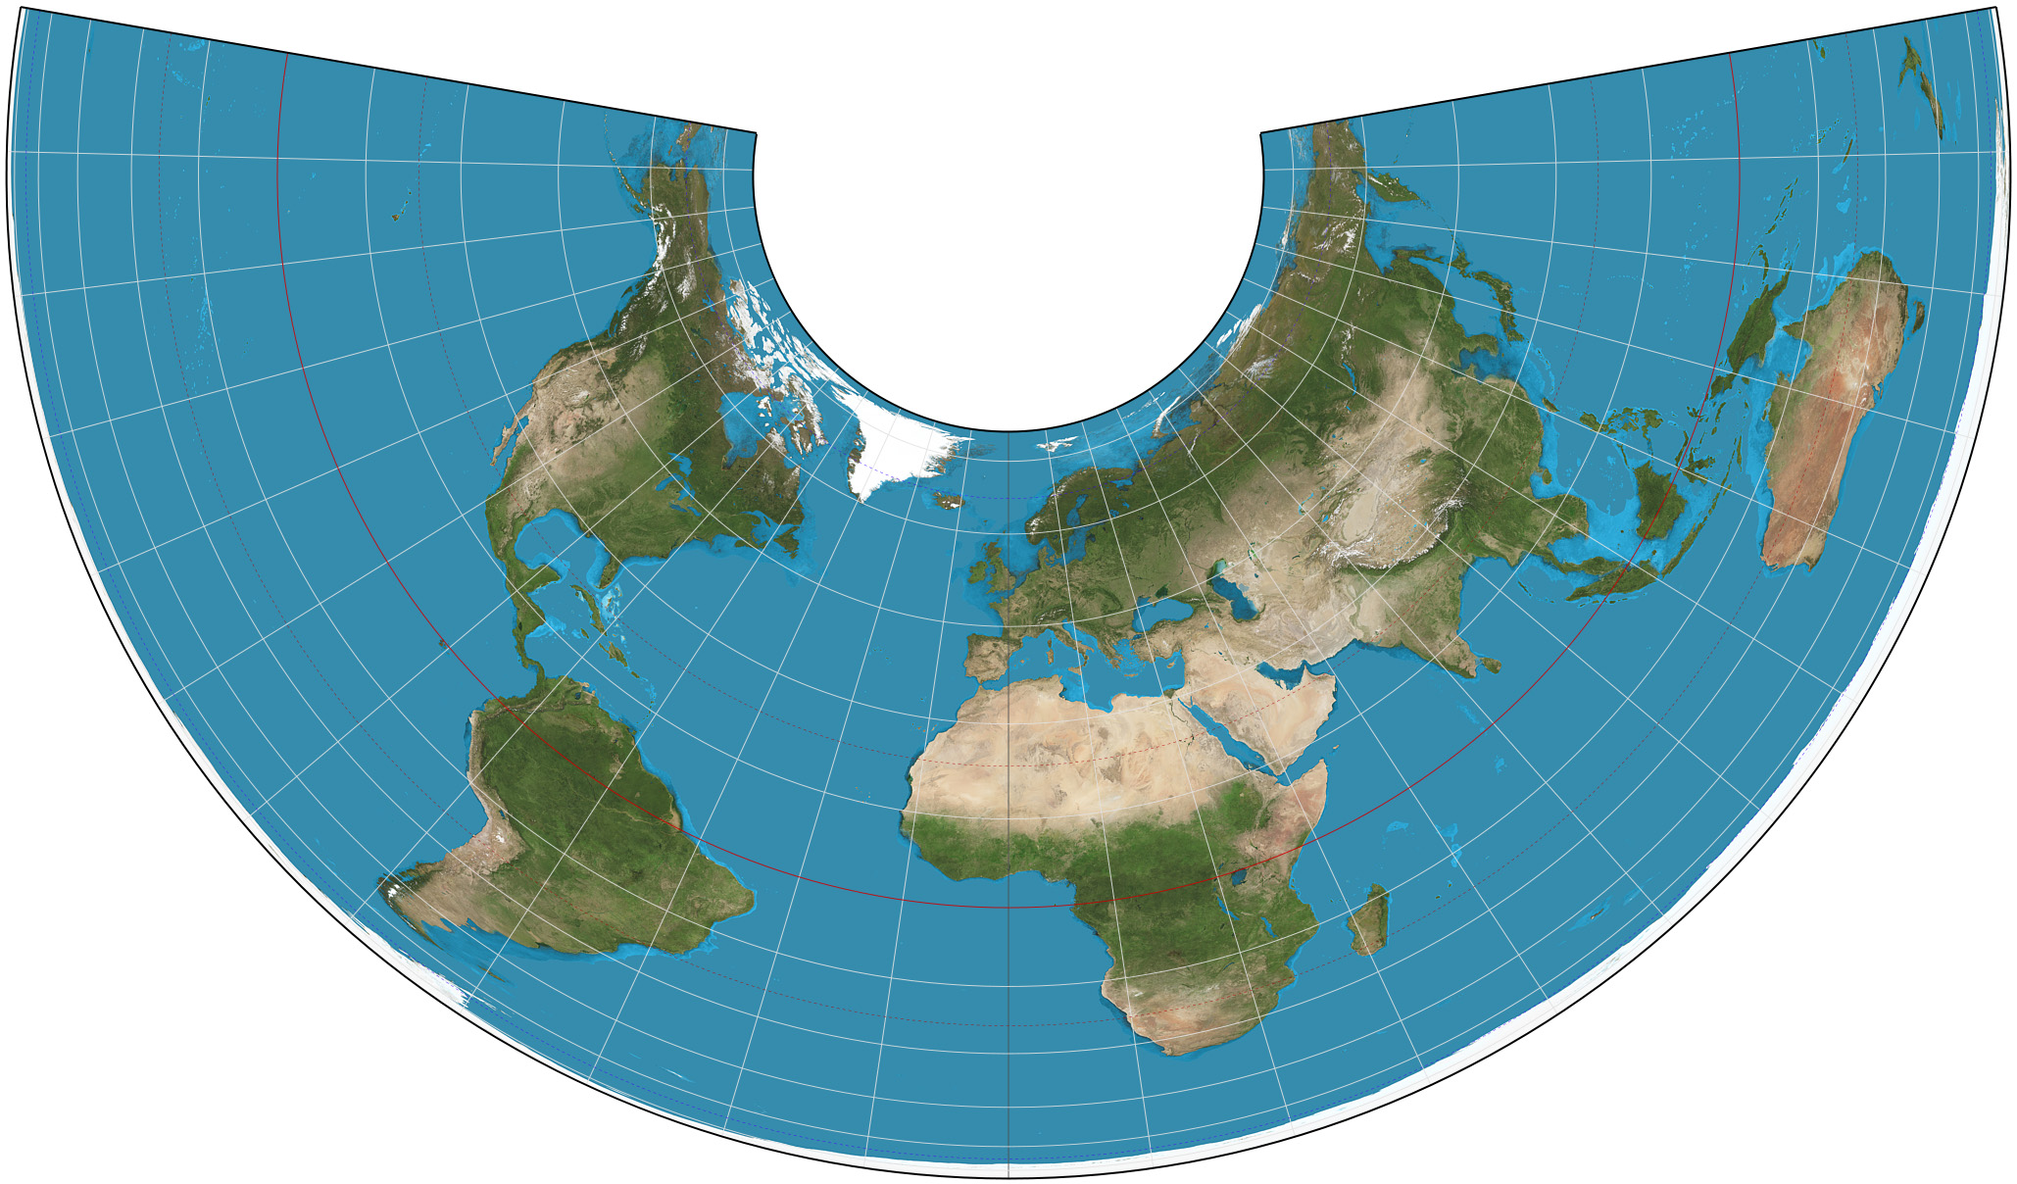
Albers Equal-Area Conic Projection
Notes:
The Albers equal-area conic projection is a conic, equal area map projection that uses two standard parallels. Although scale and shape are not preserved, distortion is minimal between the standard parallels.

Slide 4
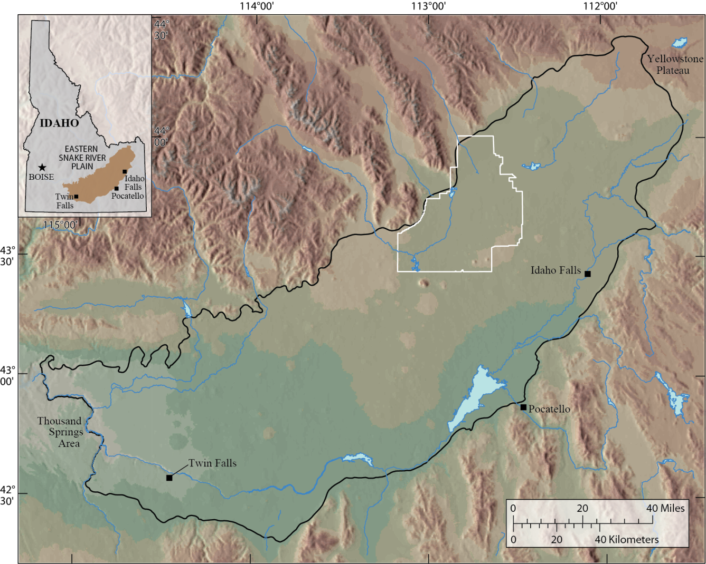
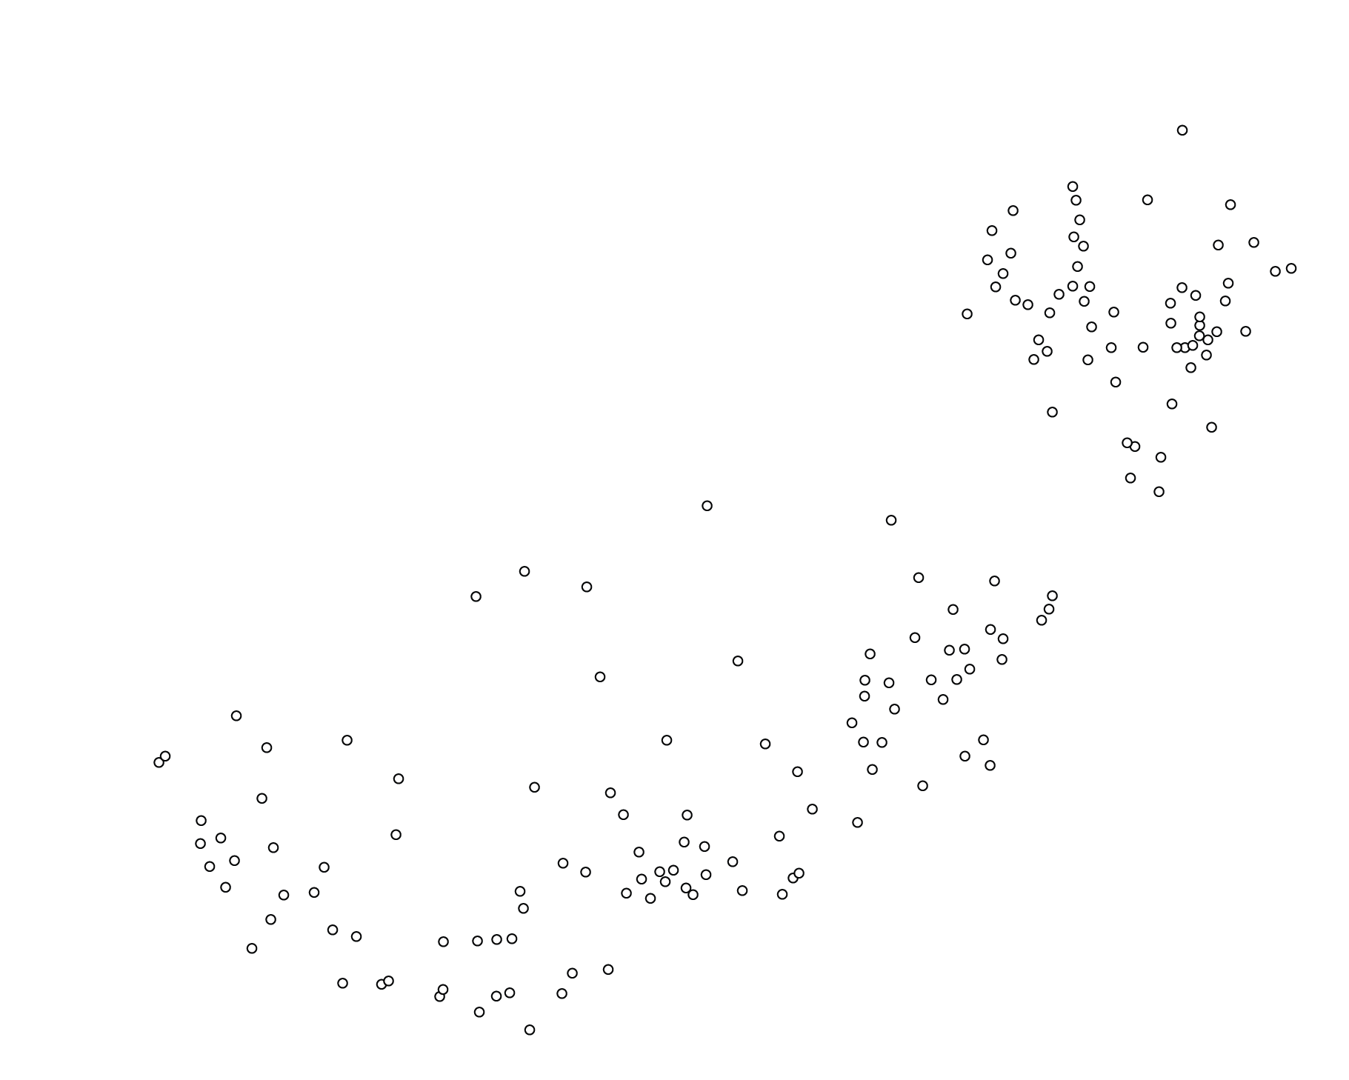
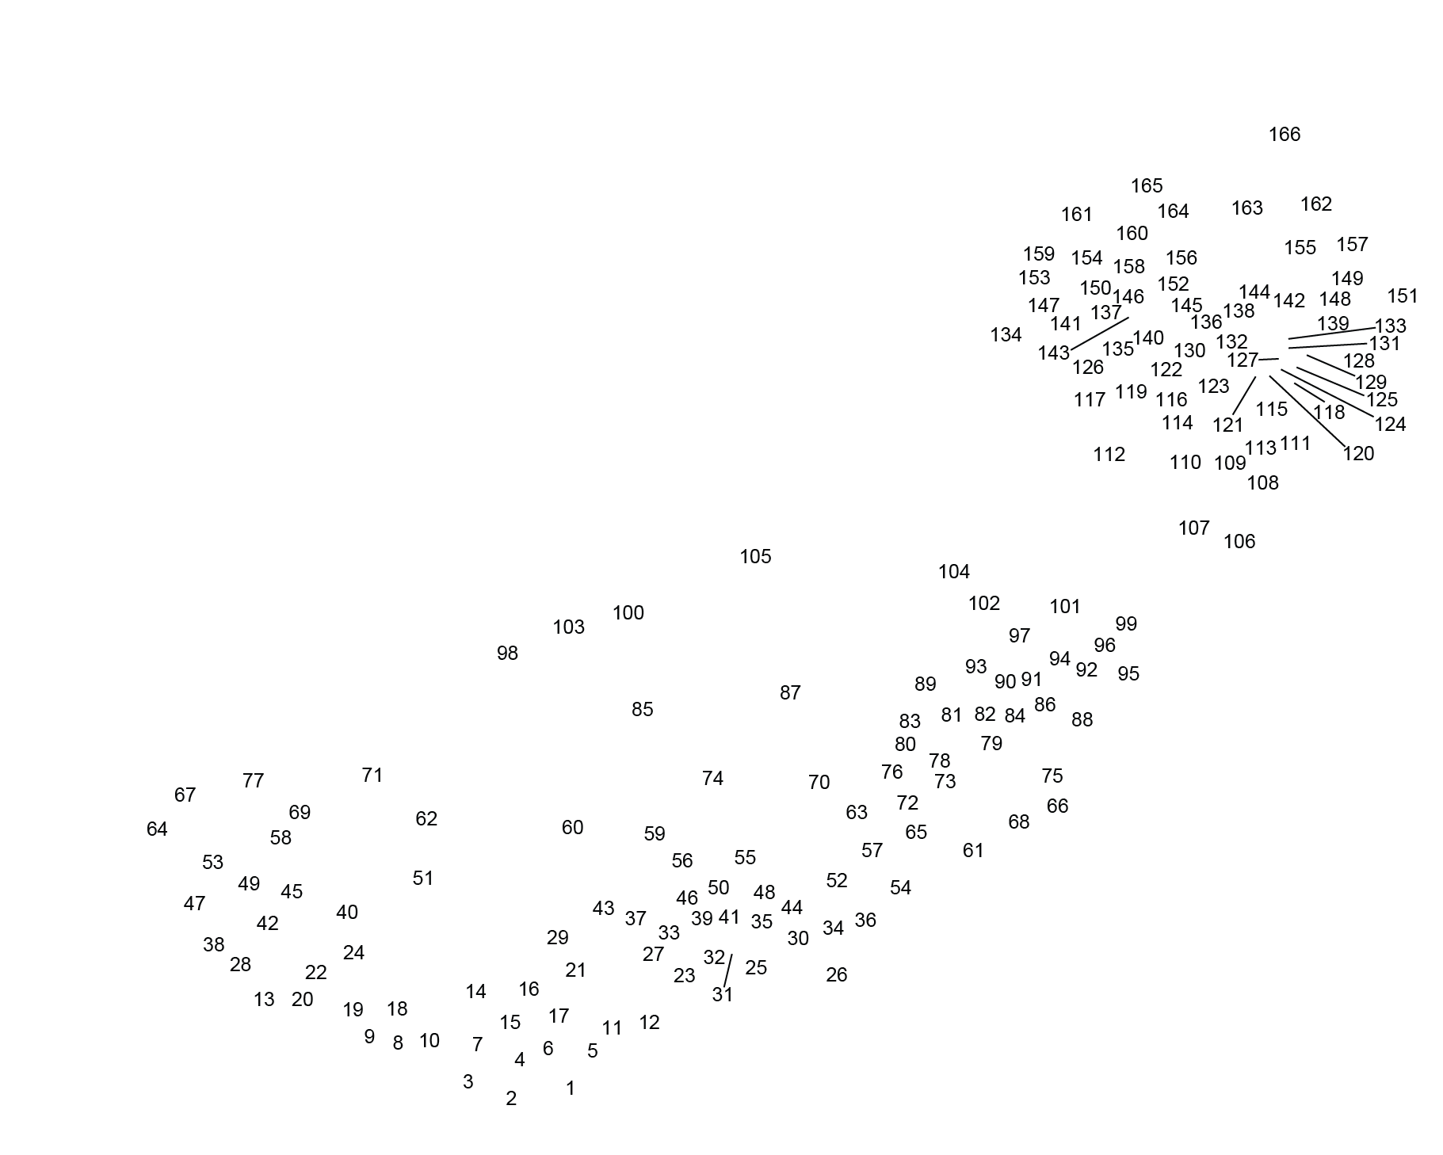
Notes:
The area of interest underlies the eastern Snake River Plain (ESRP), about 200-miles long and 50- to 70-miles wide. The plane is surrounded by mountains on three sides and rimmed by the Snake River near the edges of its eastern and southern boundaries and by canyons along its southwestern boundary.
The ESRP aquifer is primarily composed of fractured basalts, interflow zones, and interbedded sediments.
Southwest regional flow direction.
A 50-plus year history of waste disposal at the Idaho National Laboratory (INL) has resulted in measurable concentrations of contaminants in the aquifer.
State-run water-table monitoring network, as of 2008, has 166 wells.

Slide 5
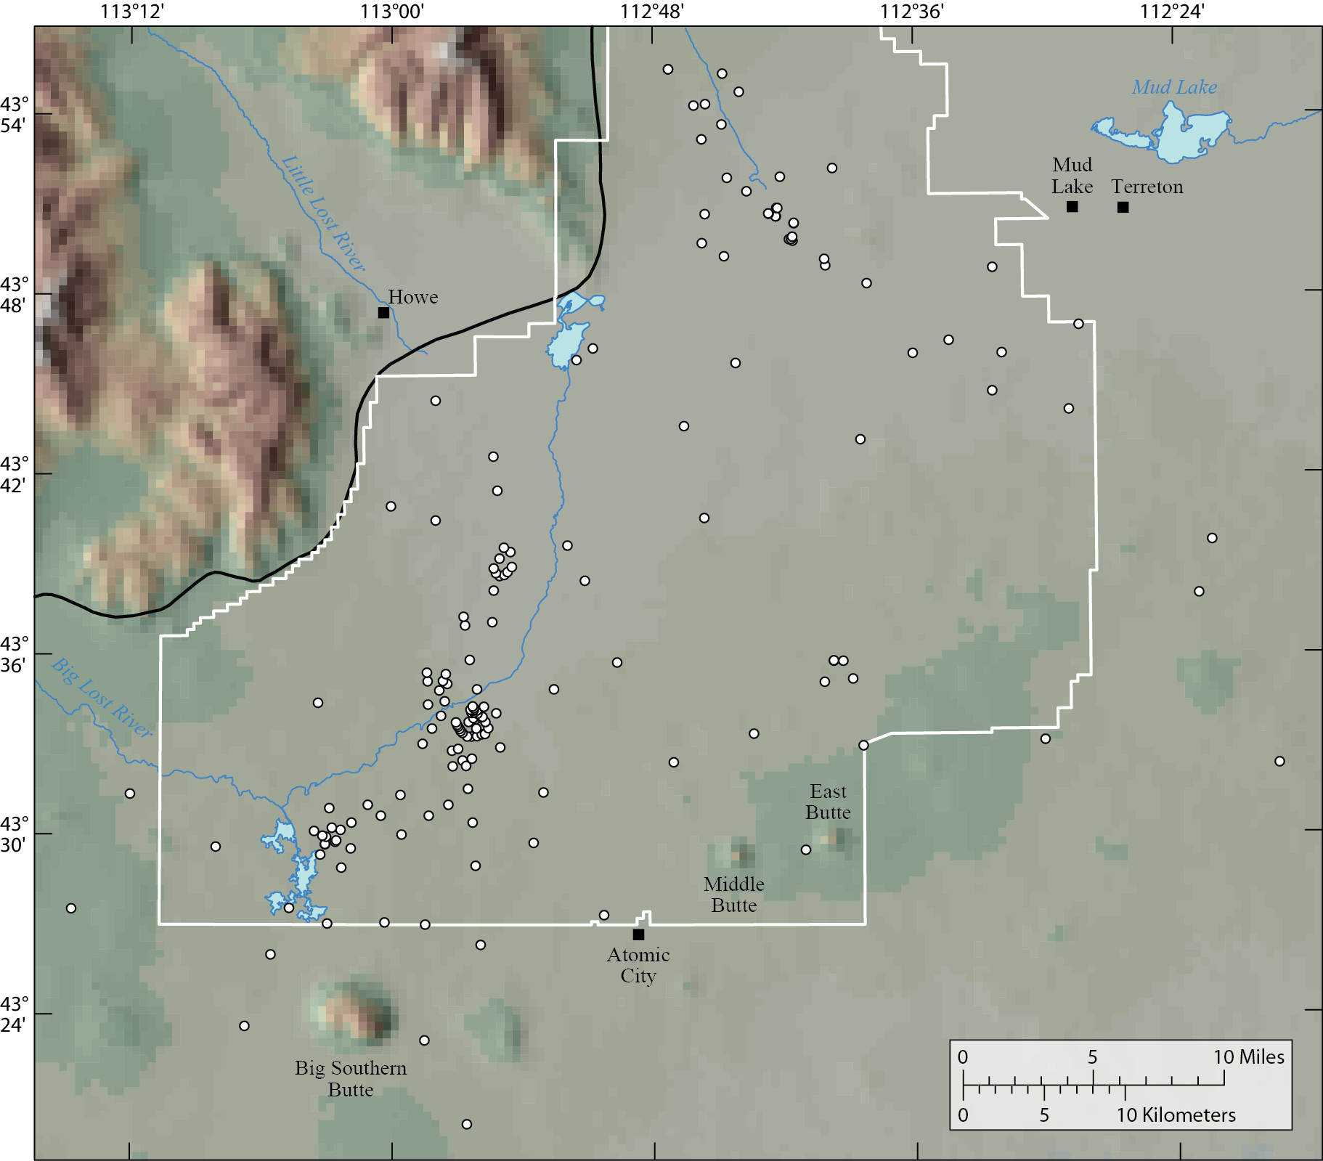
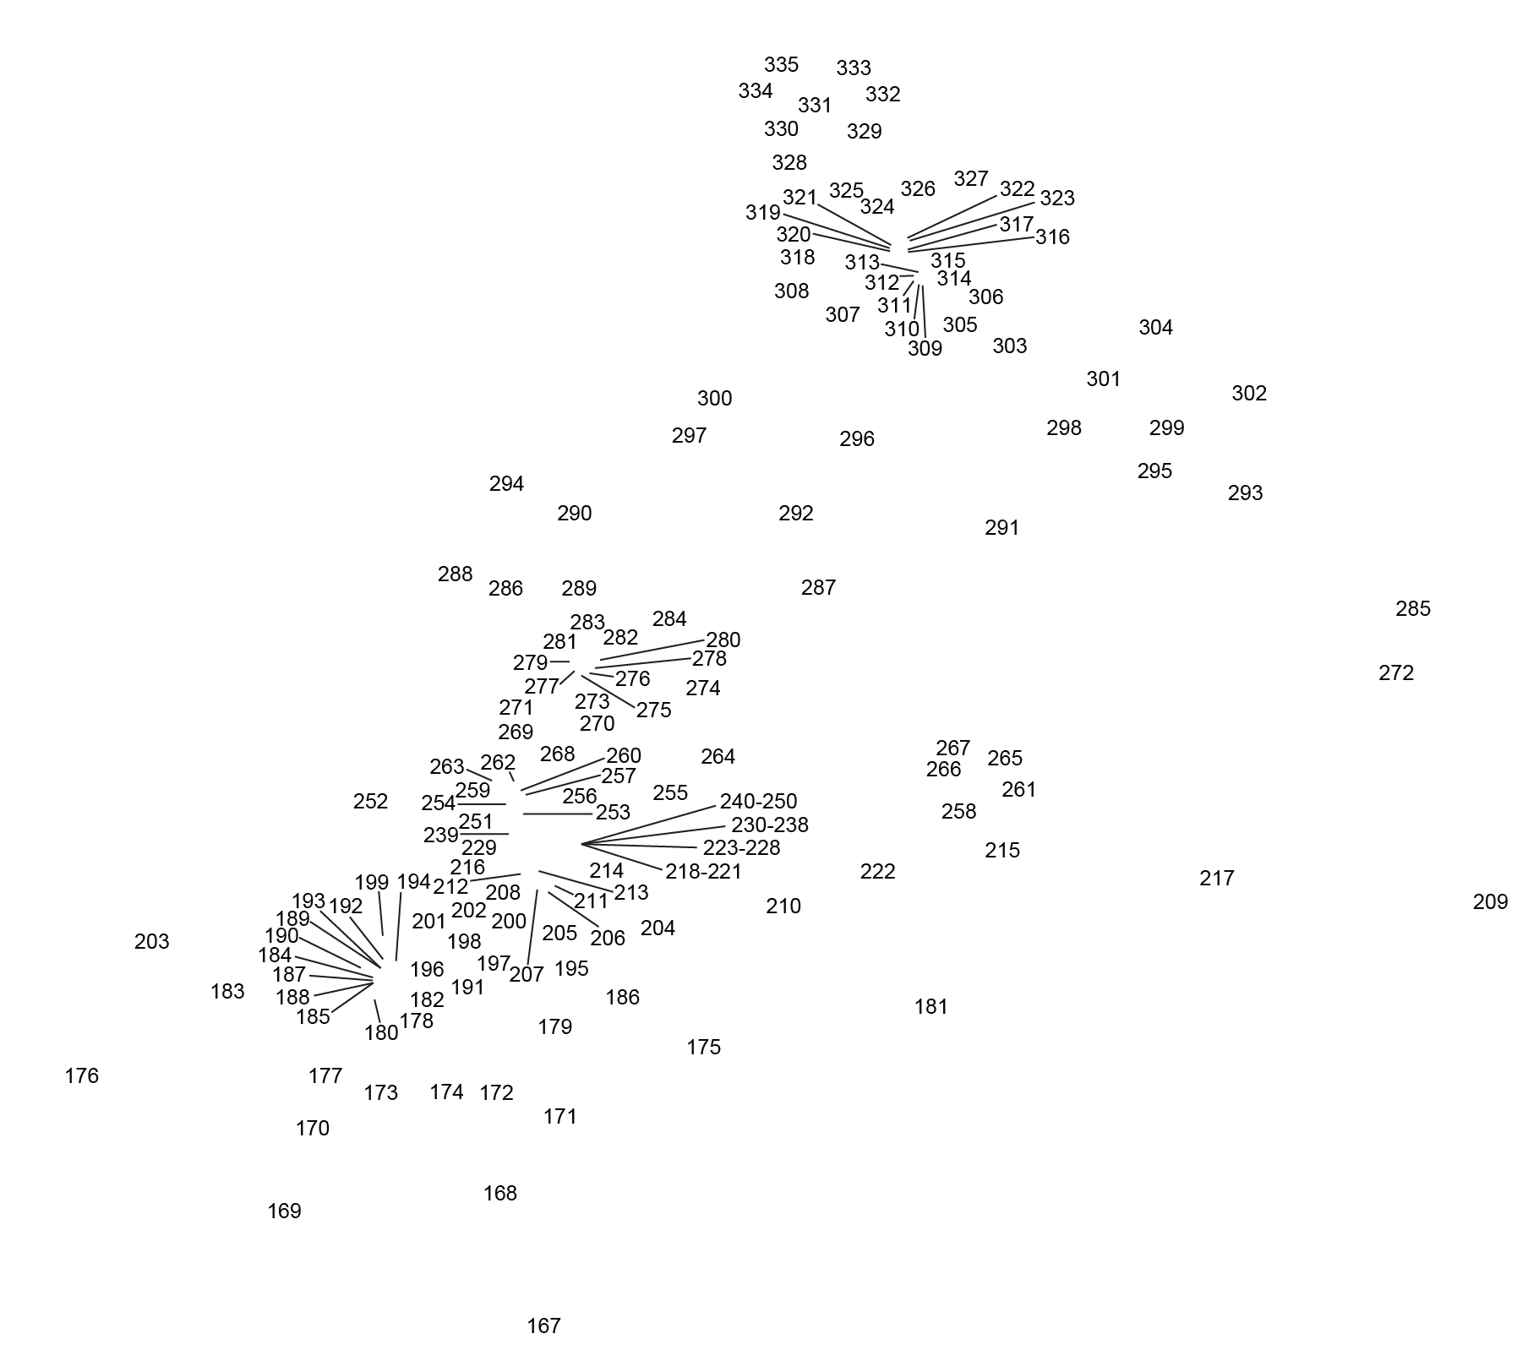
Notes:
USGS, INL, water-table monitoring network, as of 2008, has 169 wells.

Slide 6
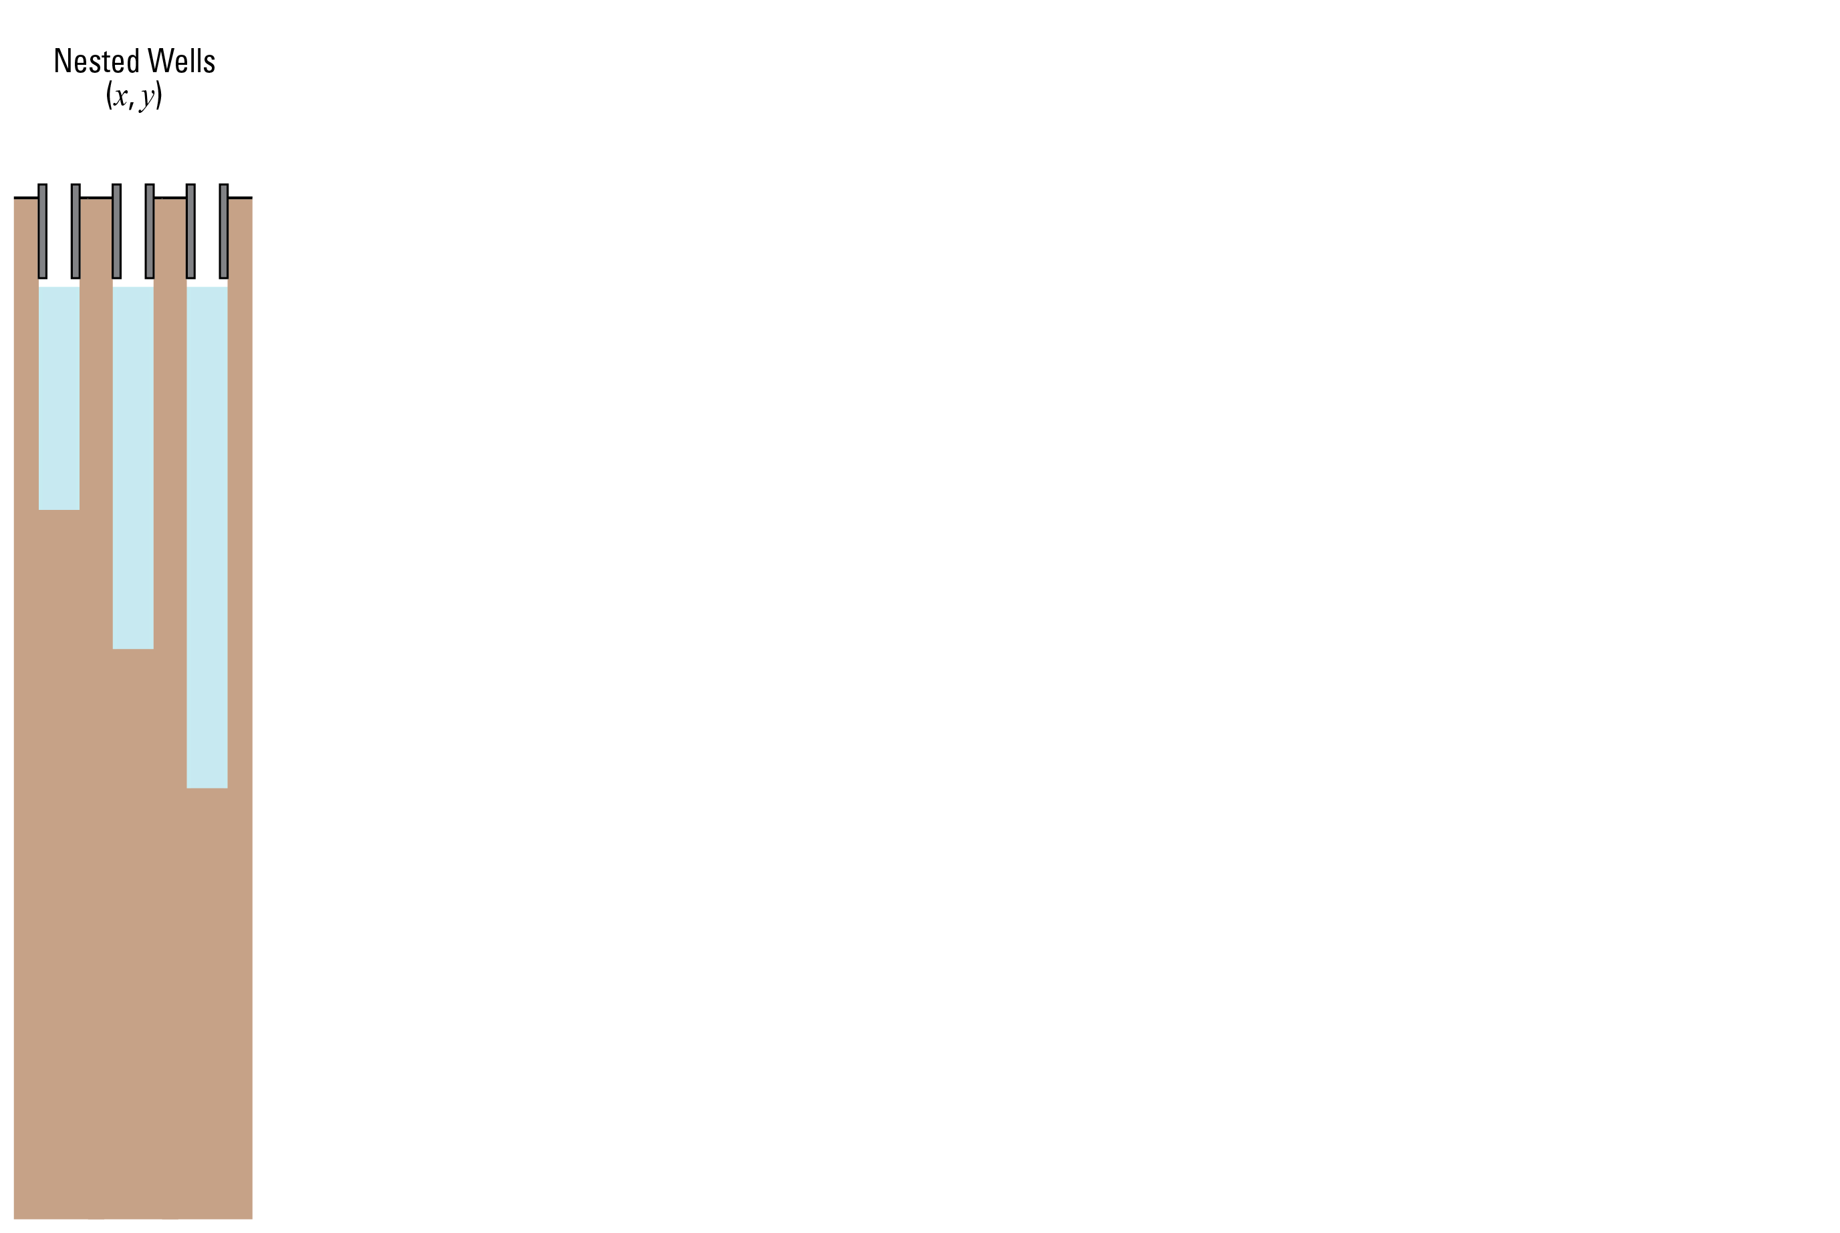
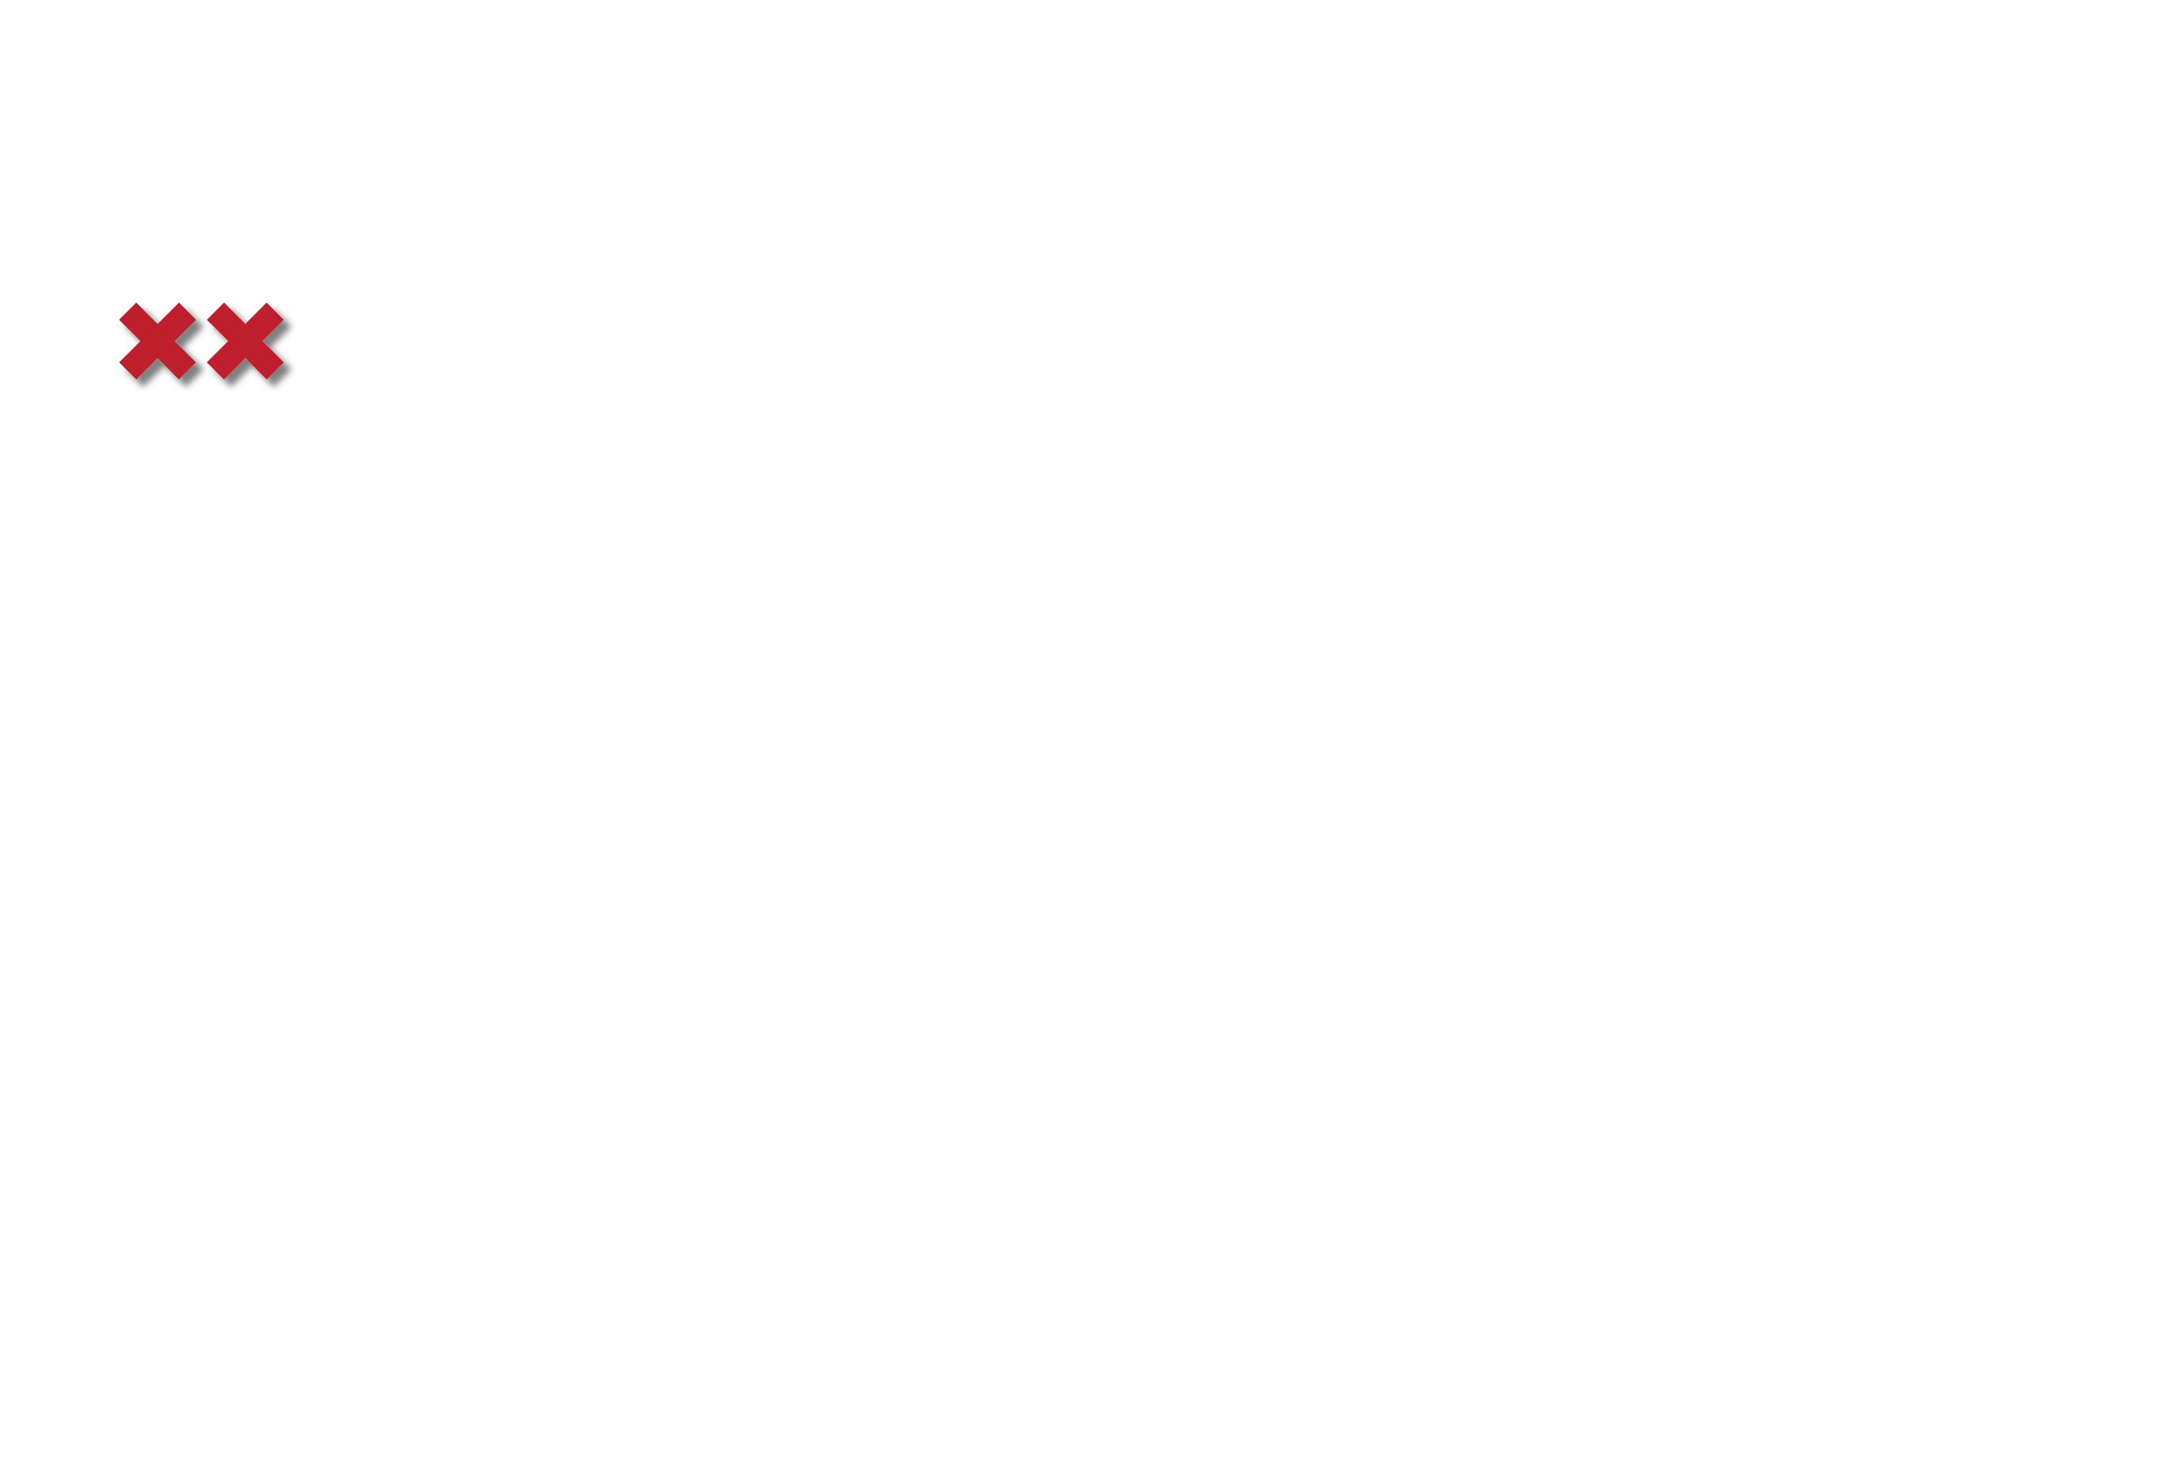
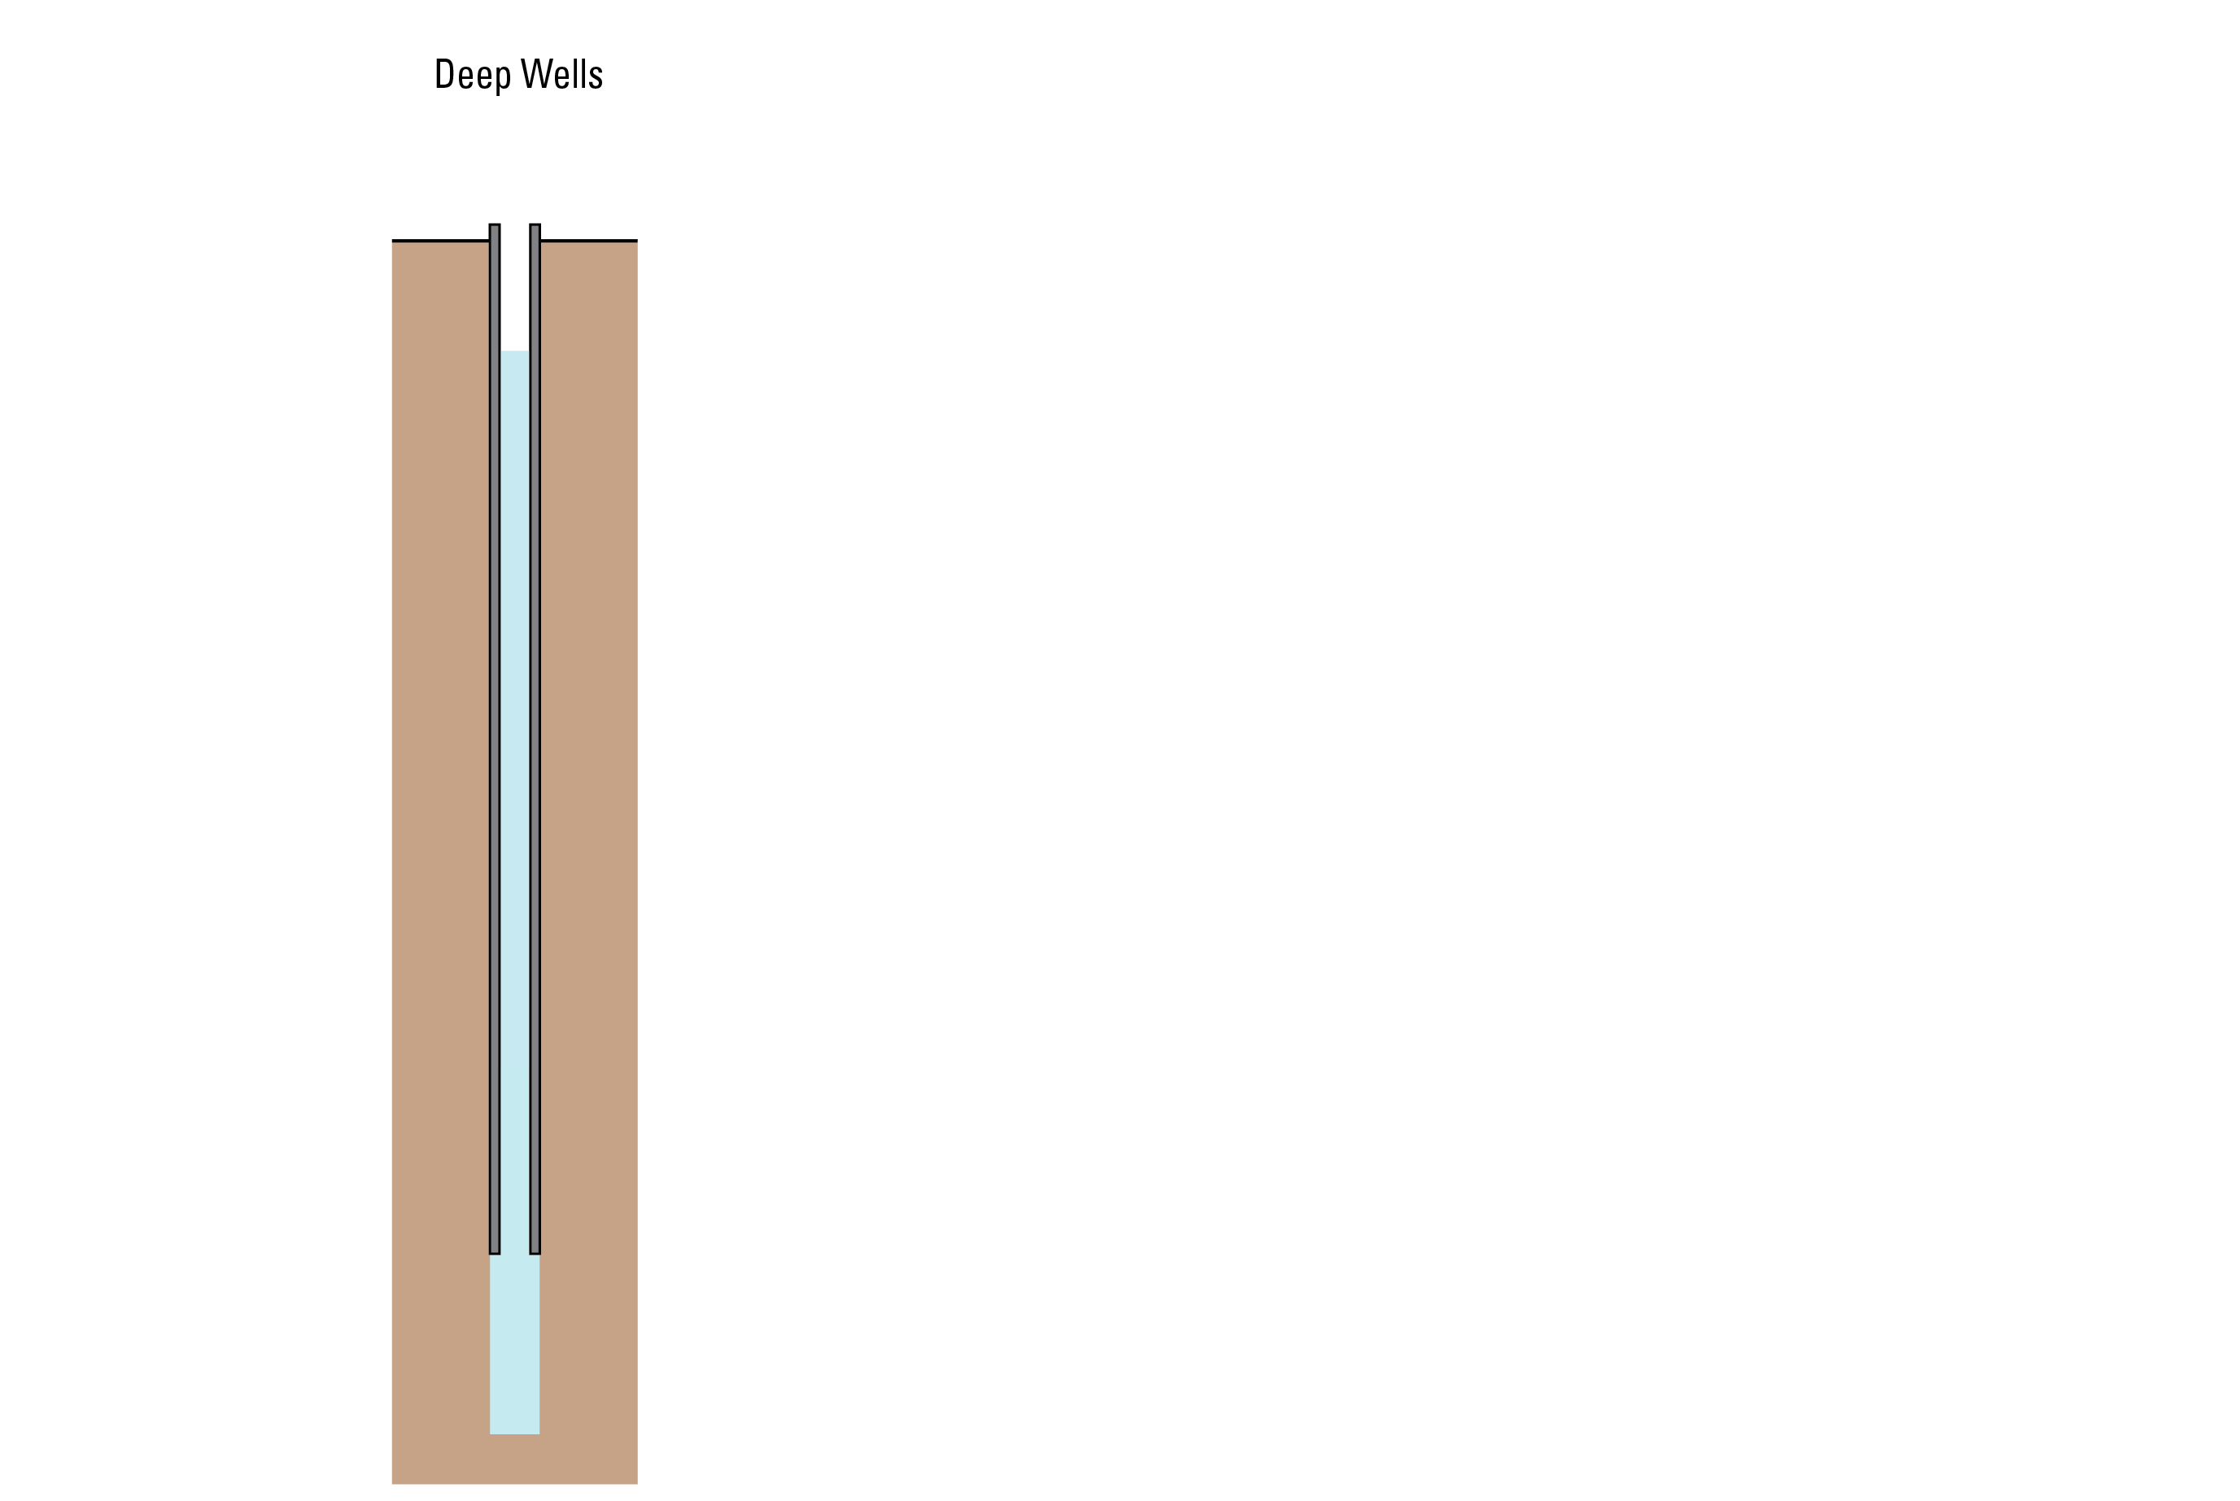
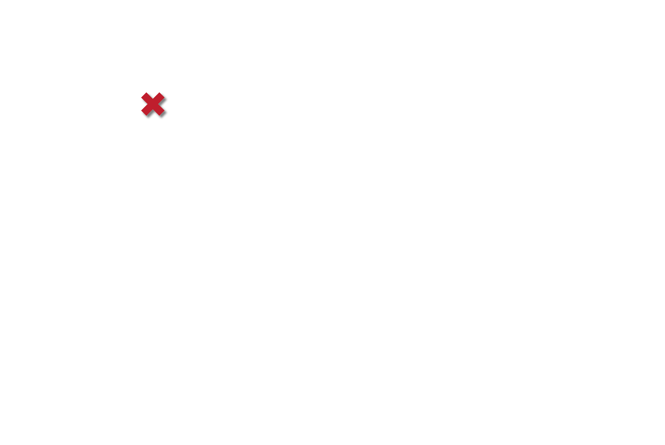
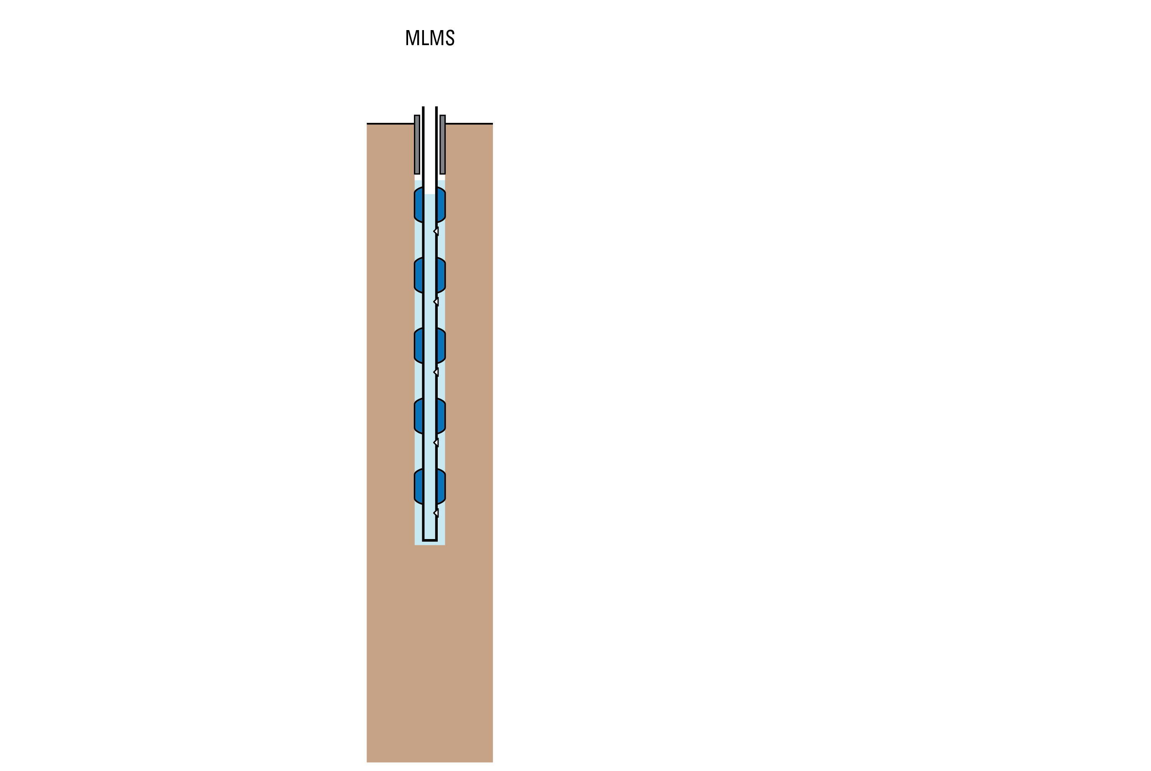
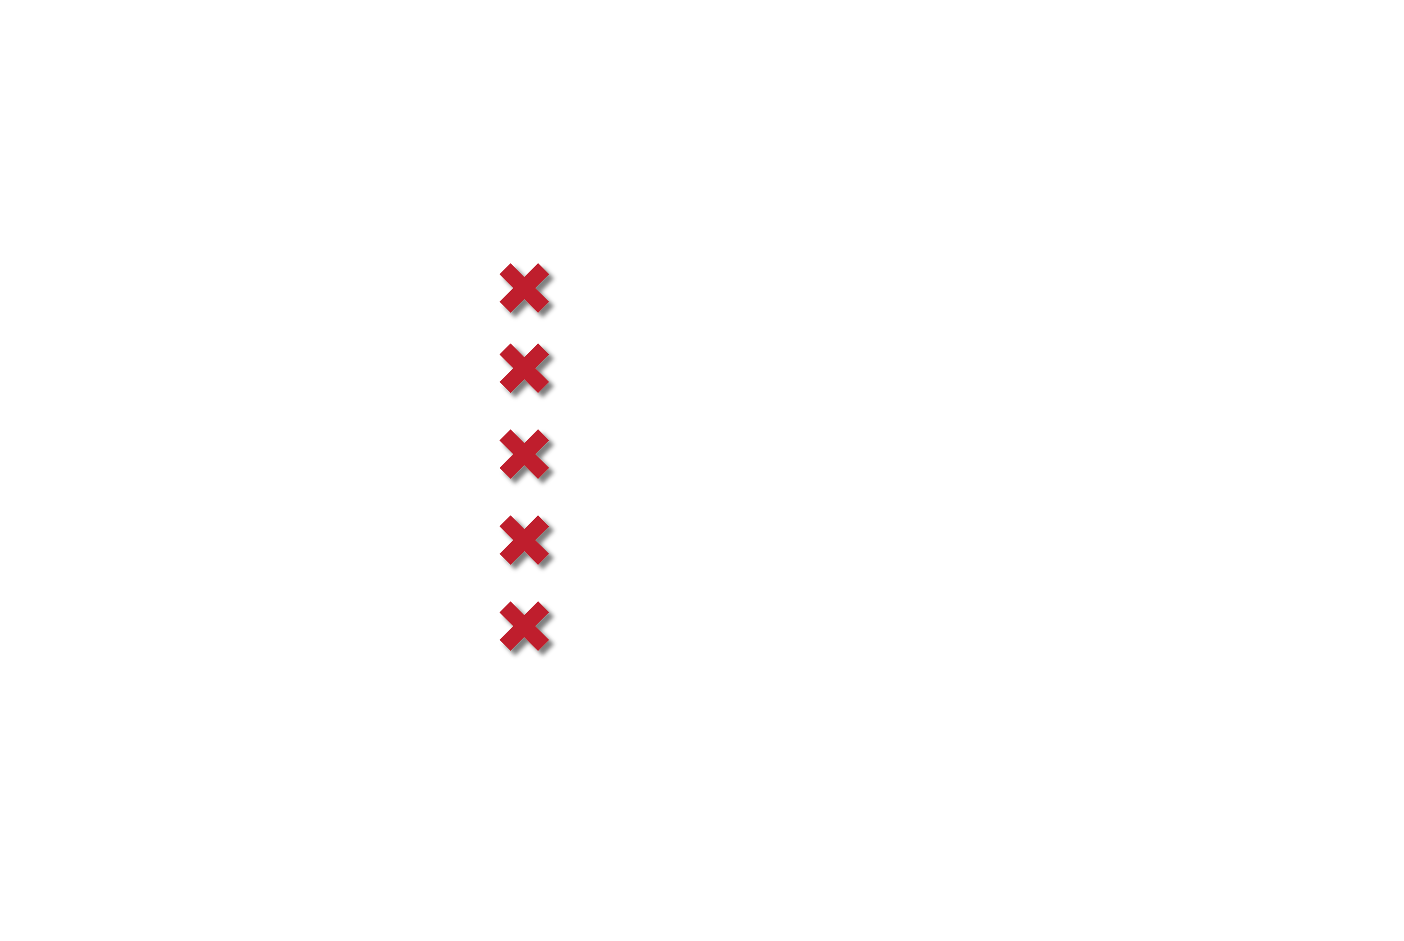
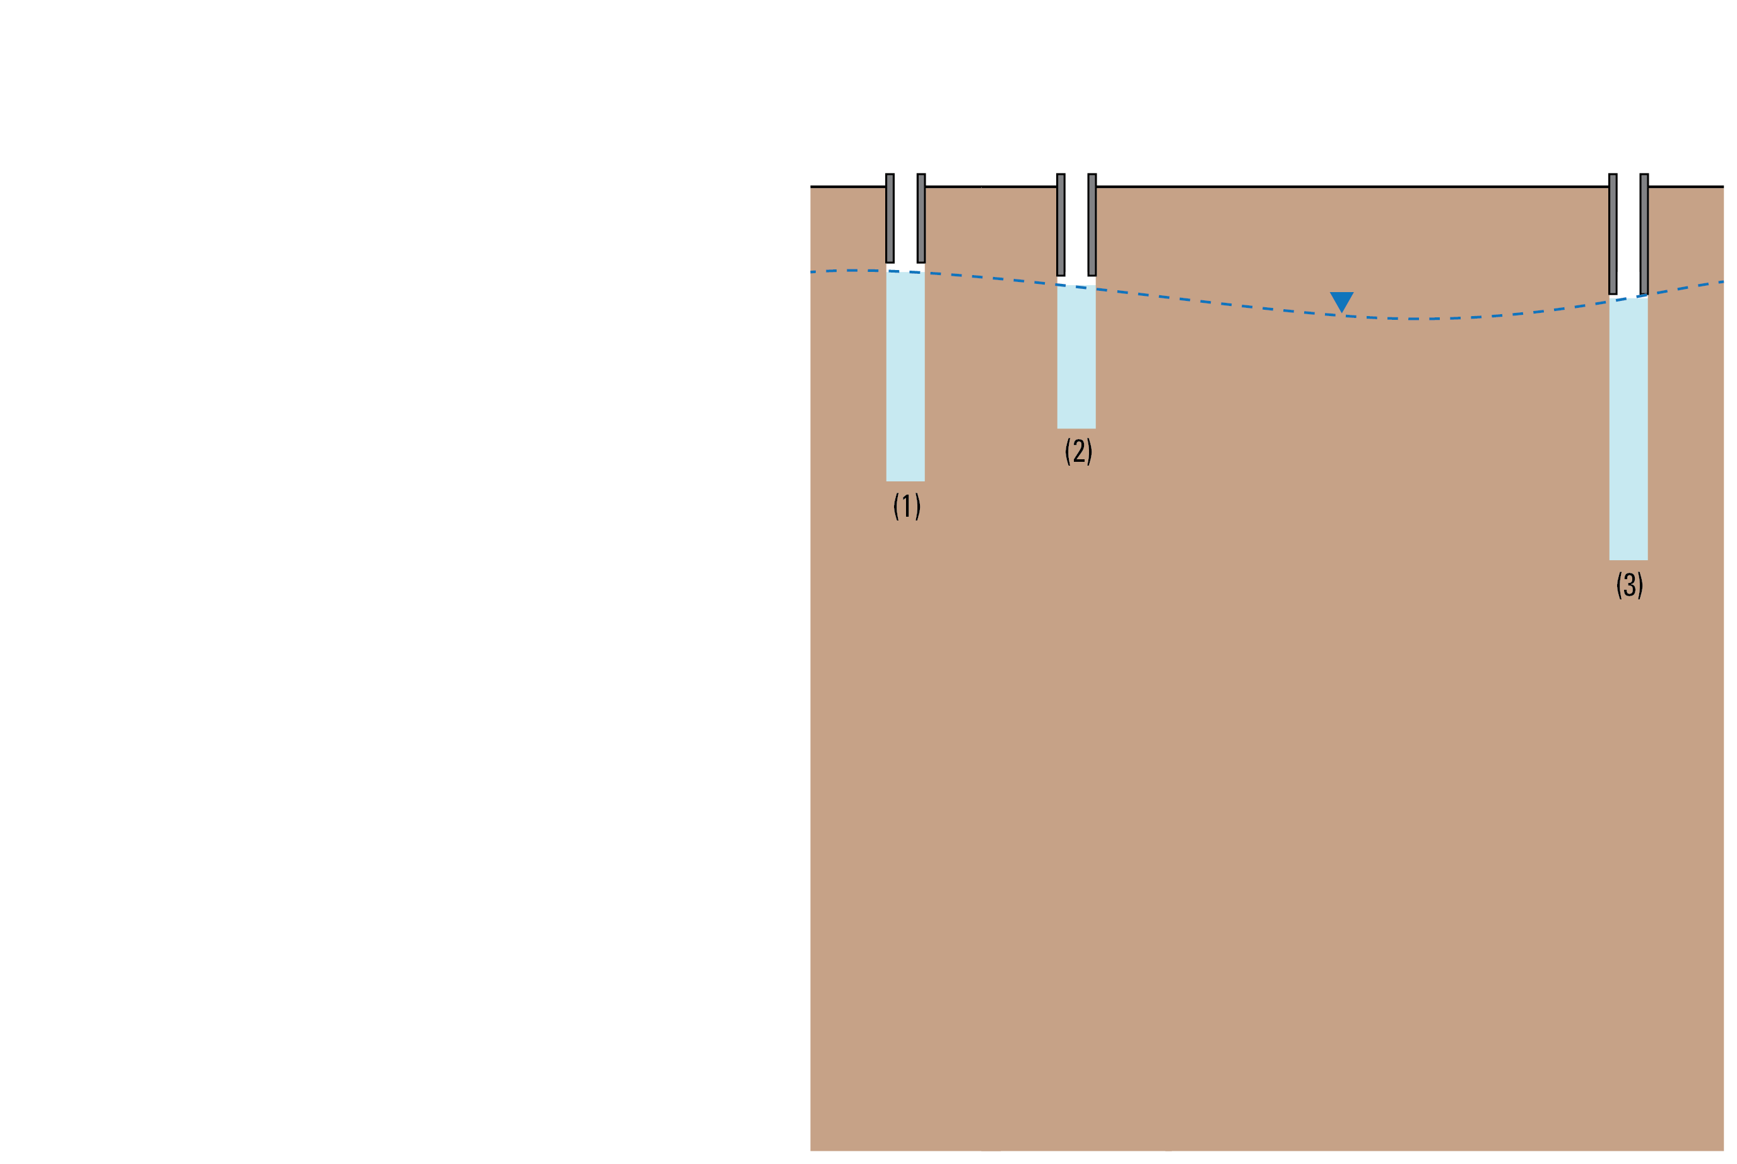
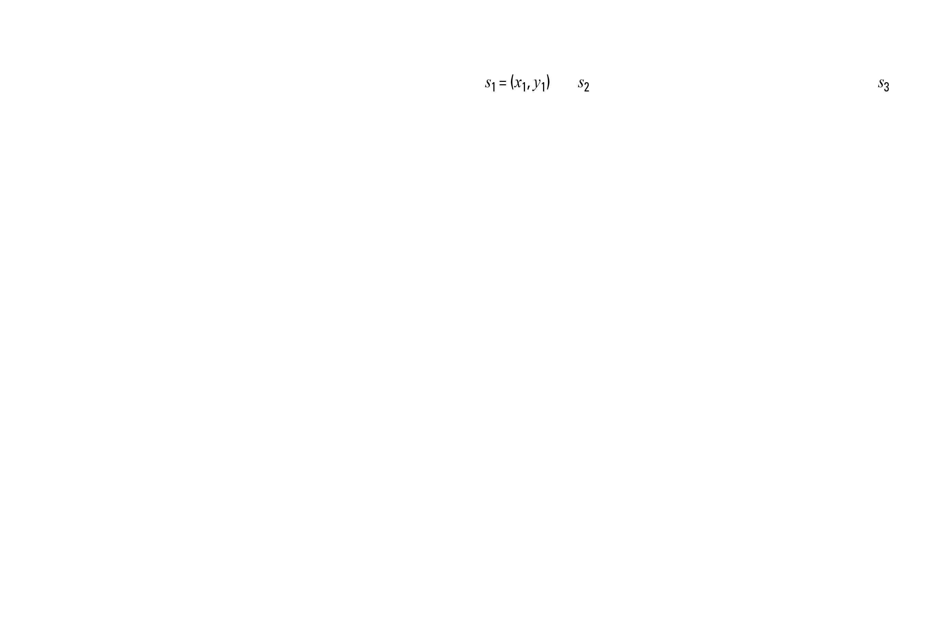
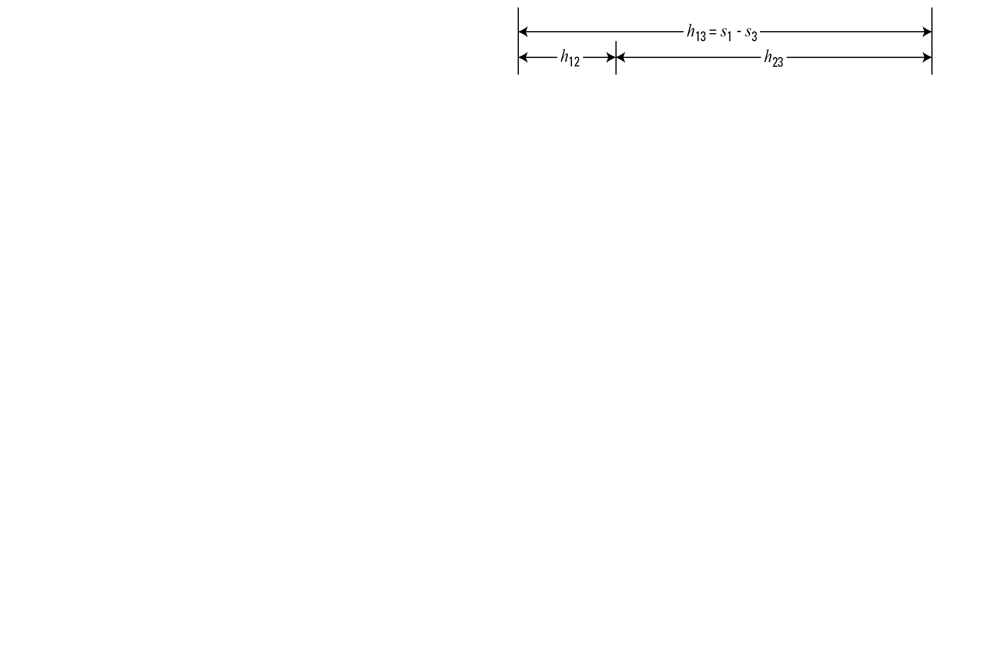
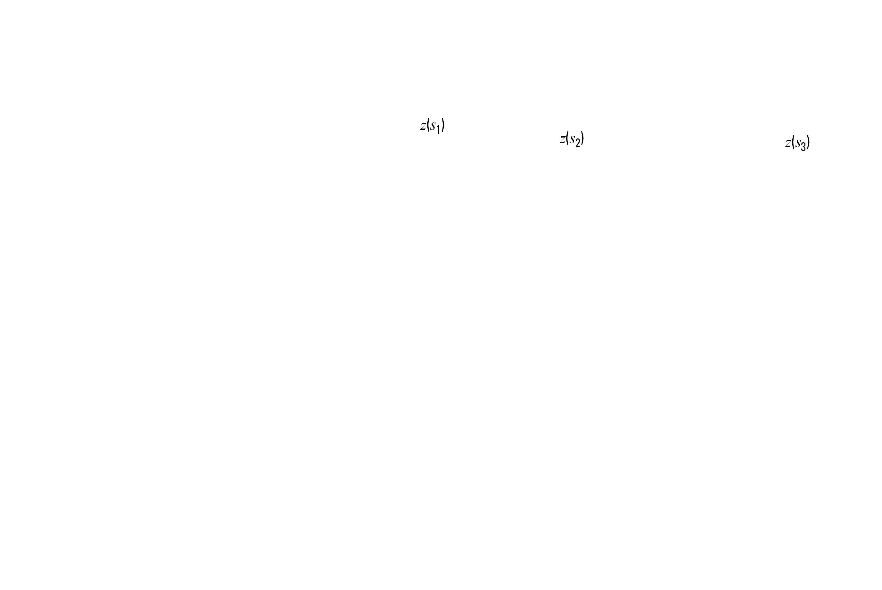
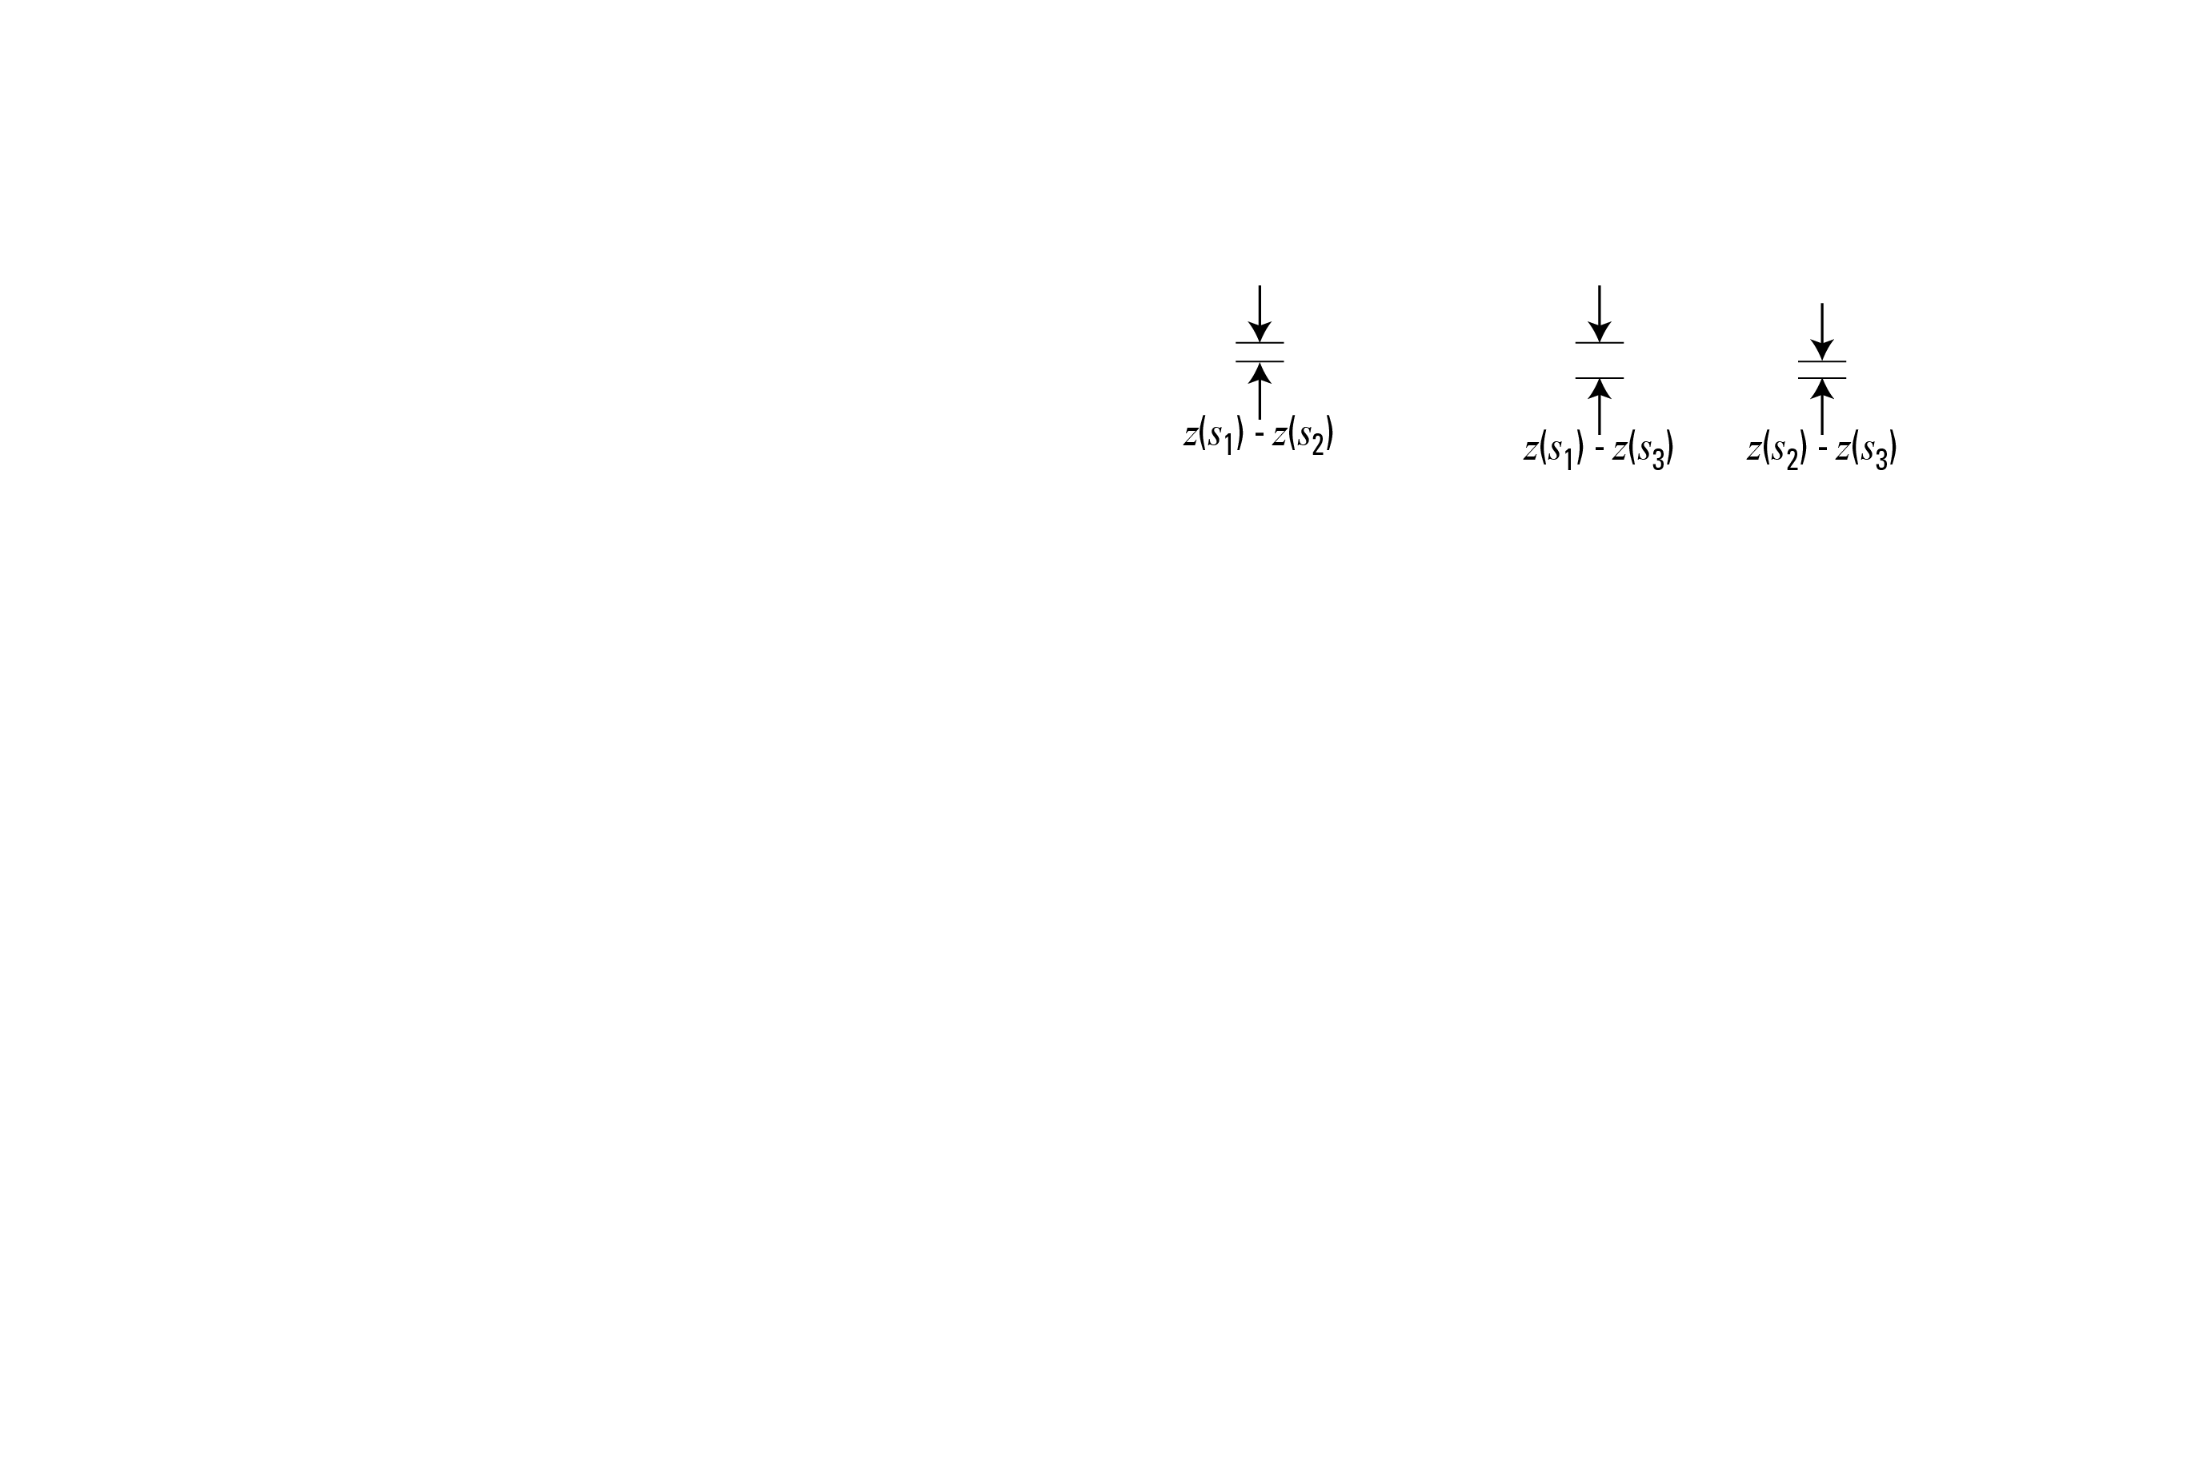

Slide 7
Kriging
A geostatistical technique, used in this study to interpolate and extrapolate the water-table elevation at unmeasured locations in the aquifer.
The value at an unmeasured location is estimated as a weighted average of the measured values.
Kriging computes an estimate best representing the spatial distribution of the measured values based on the semivariogram model and a minimization of the estimation variance (or estimation error) at measured locations.
Key assumption
Stationarity requires that the mean of the data being estimated does not change when shifted in space, and the modeled semivariogram is the same everywhere.

Slide 8
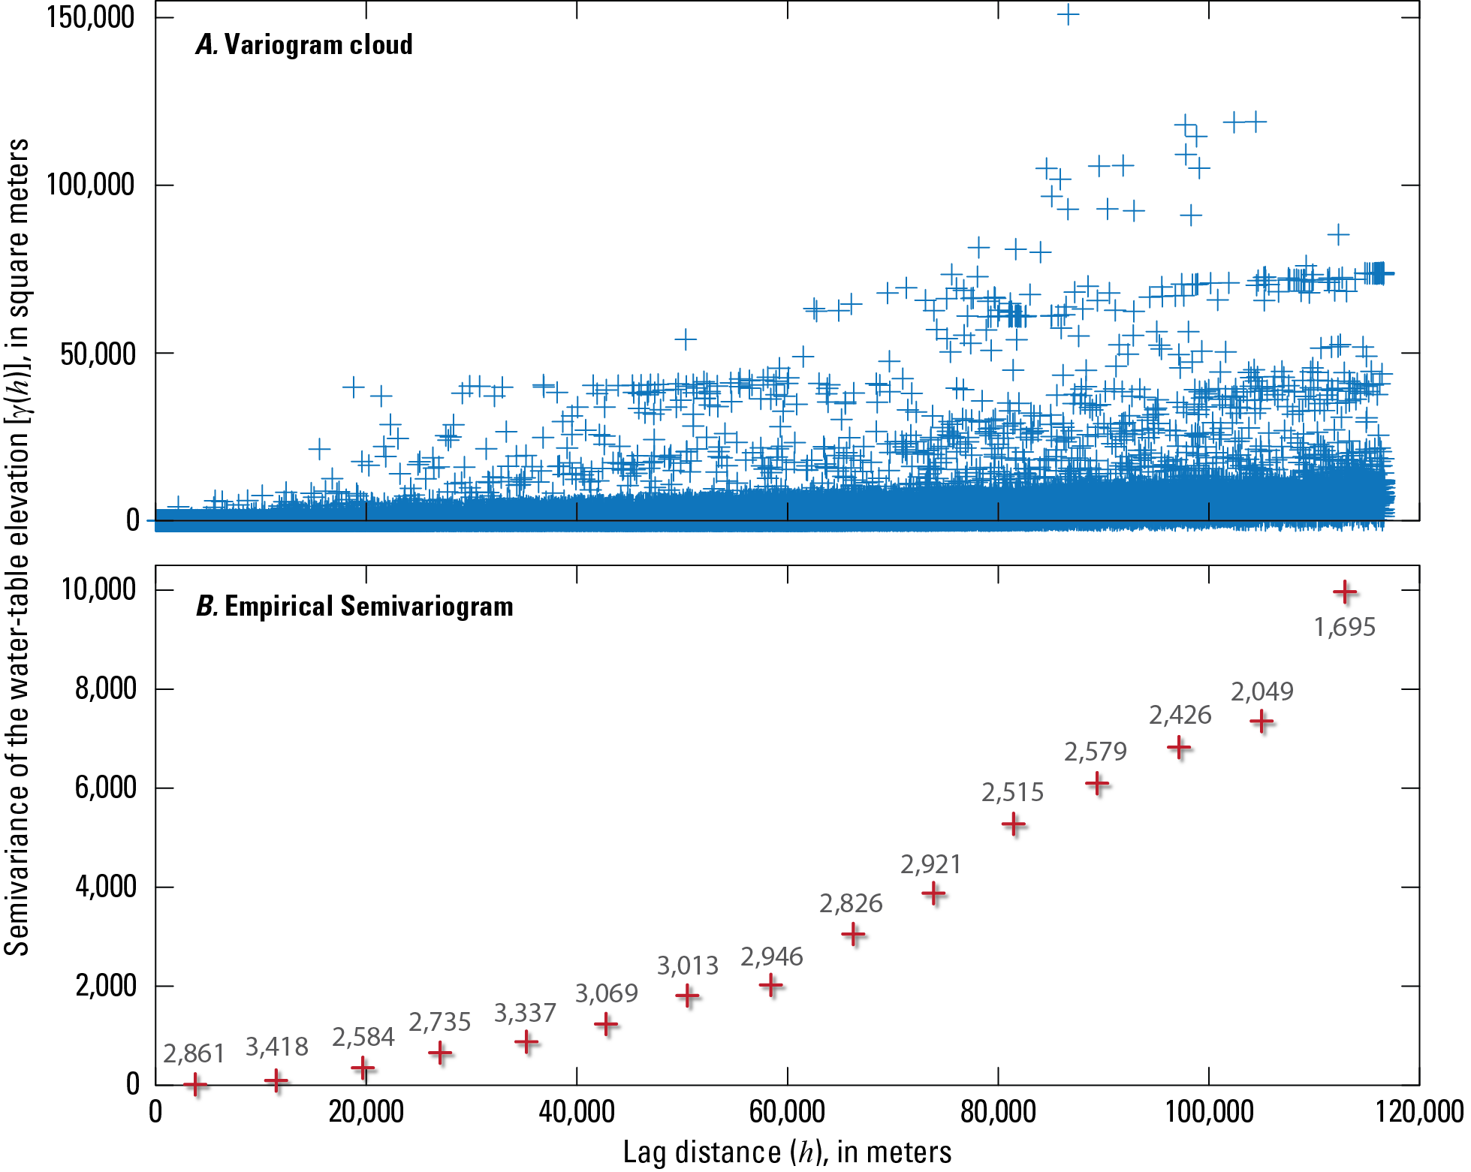
Notes:
The presence of spatial trends in the data is indicated by a parabolic empirical semivariogram shape. Invalidates the stationarity assumption.

Slide 9
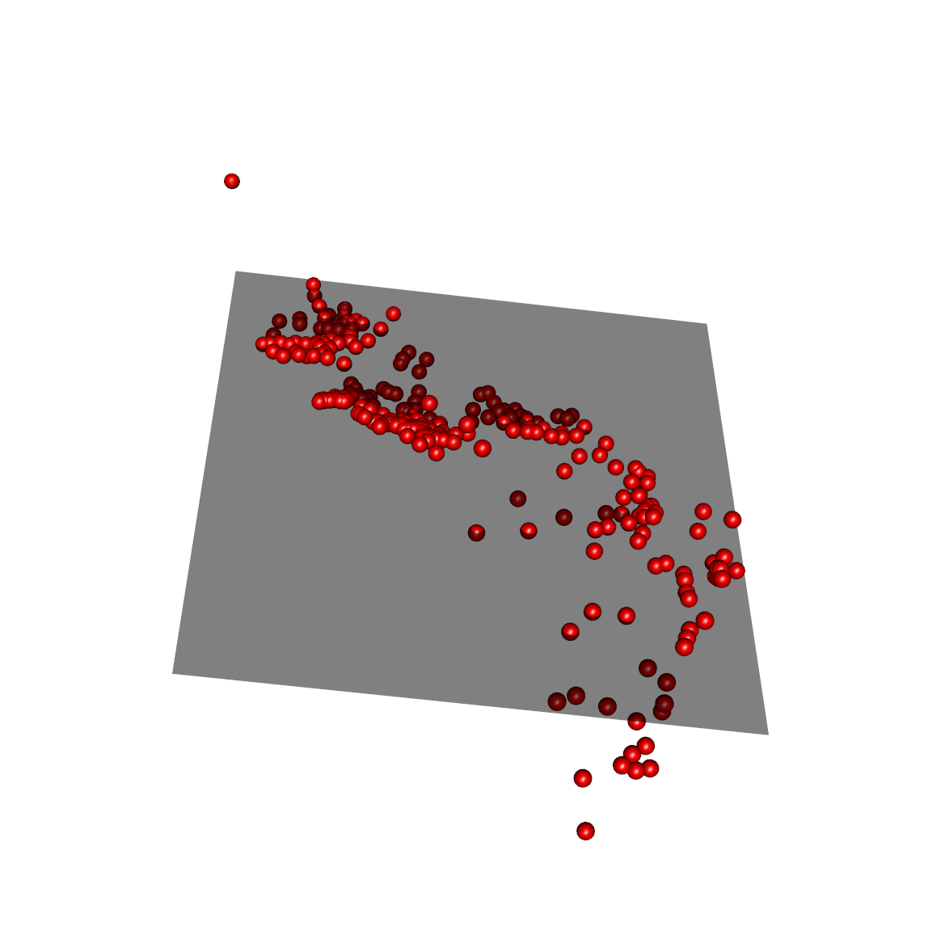

Universal Kriging (UK)

Slide 10
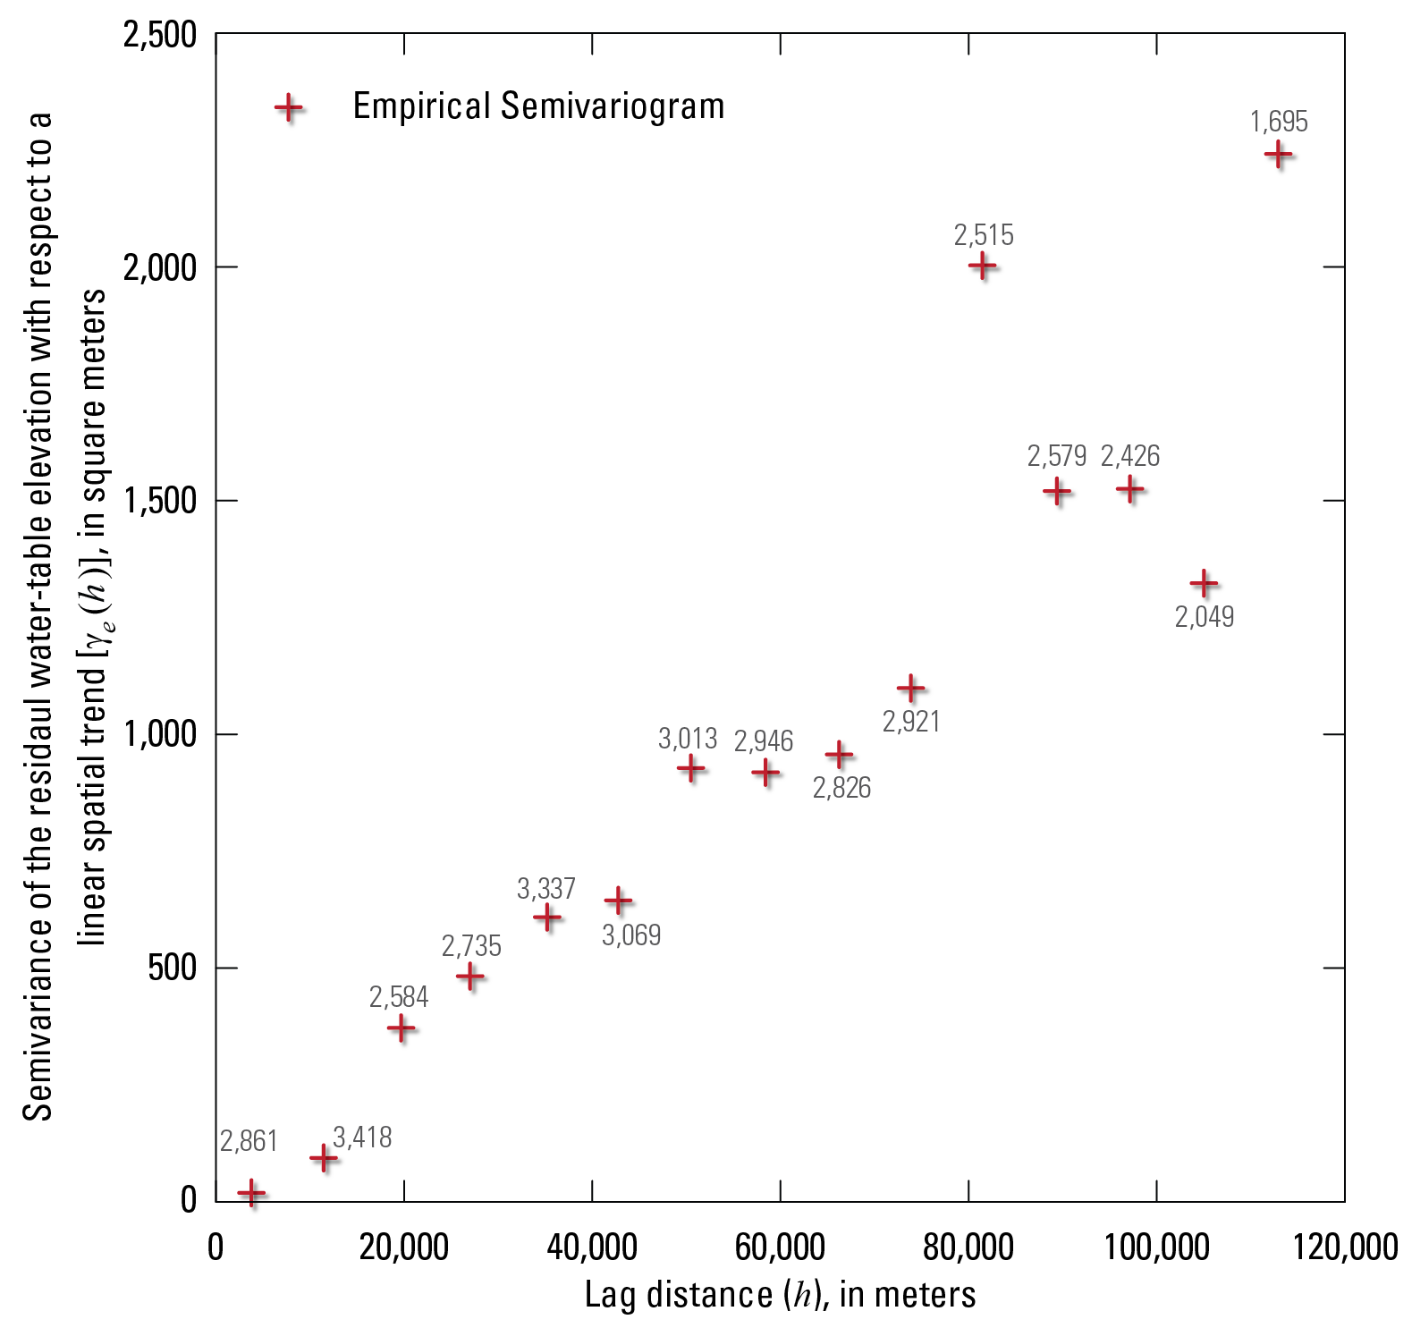
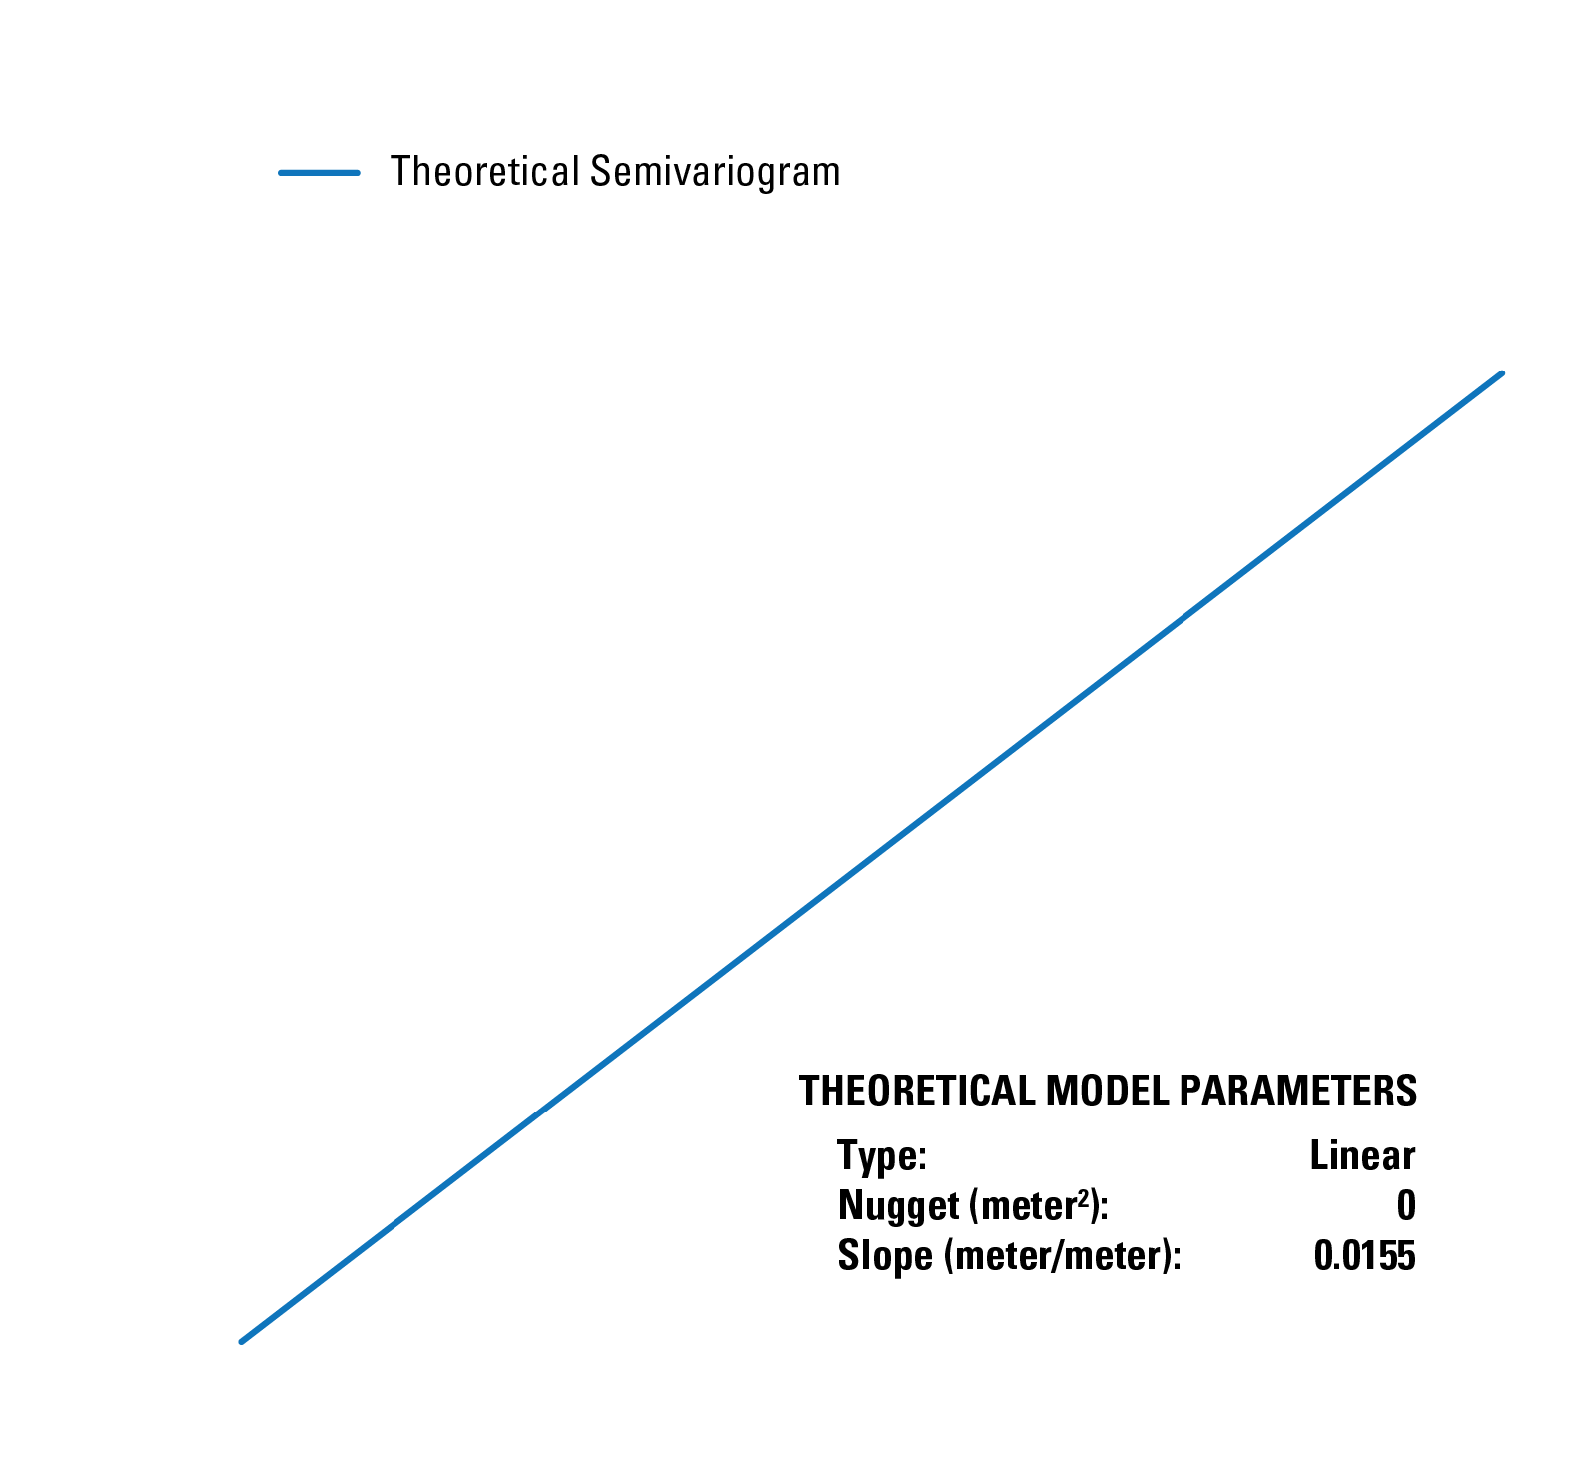

Slide 11
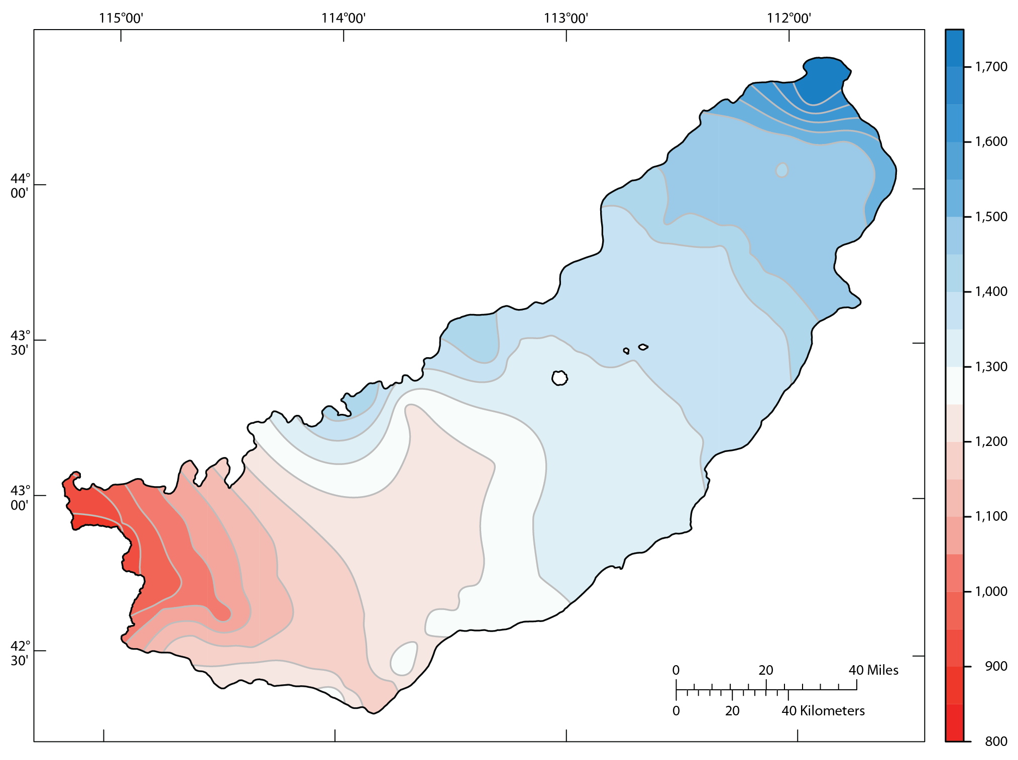
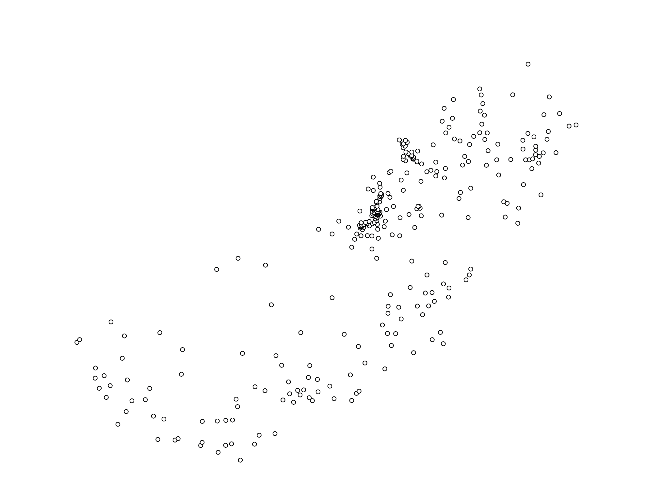
UK

Slide 12
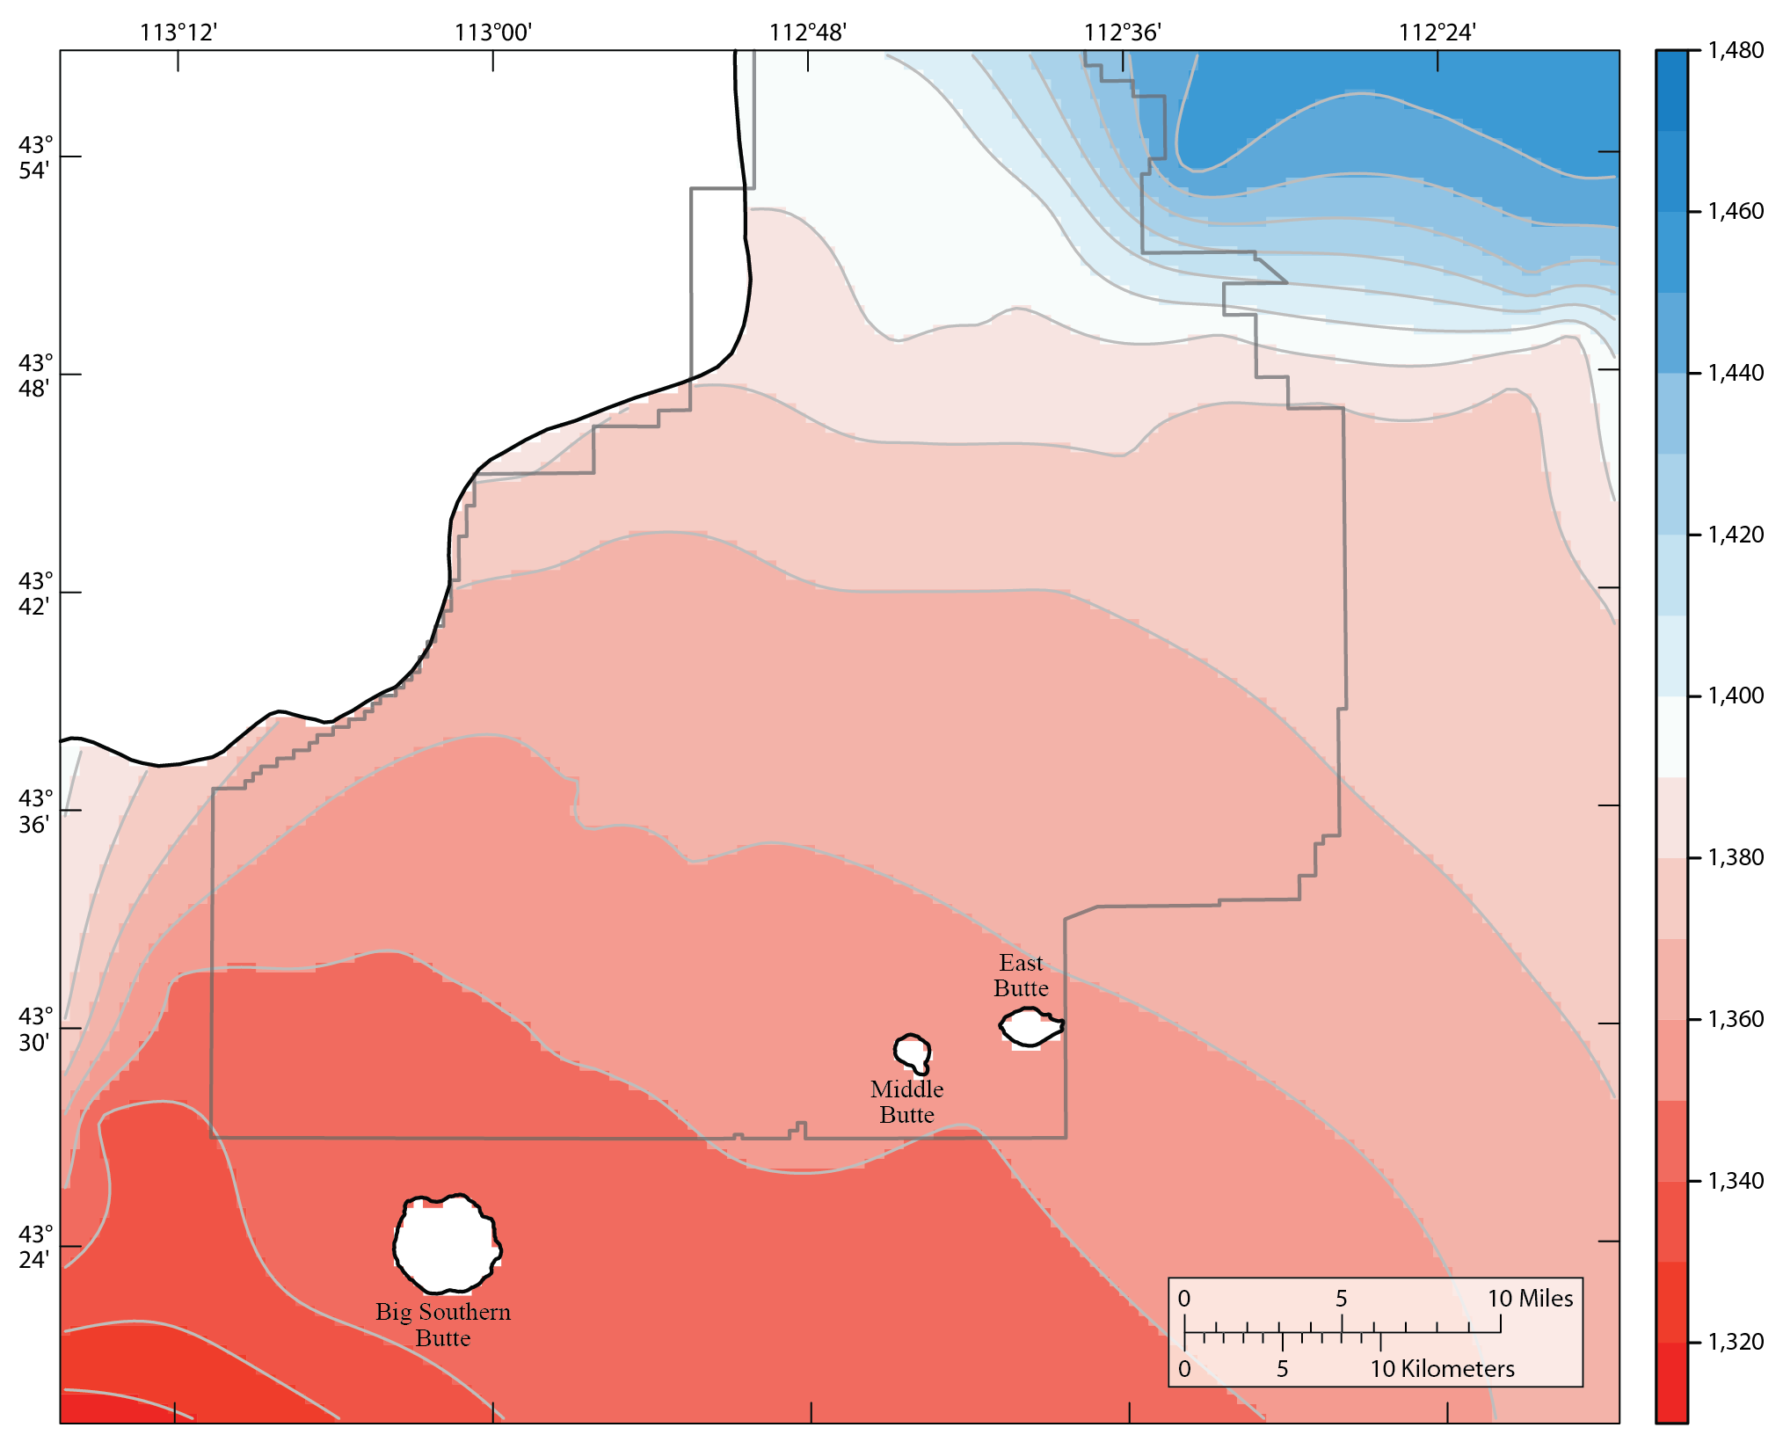
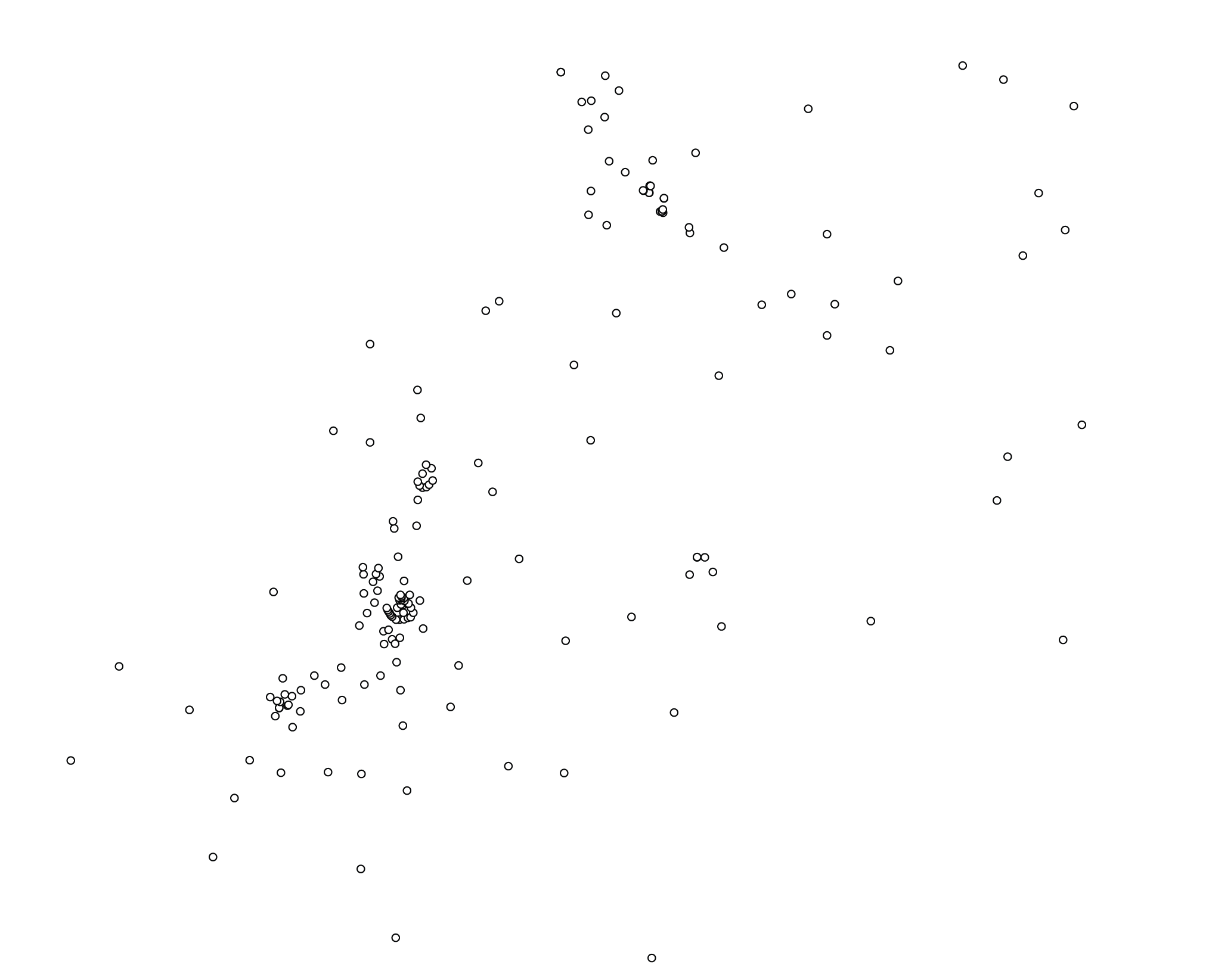
UK

Slide 13
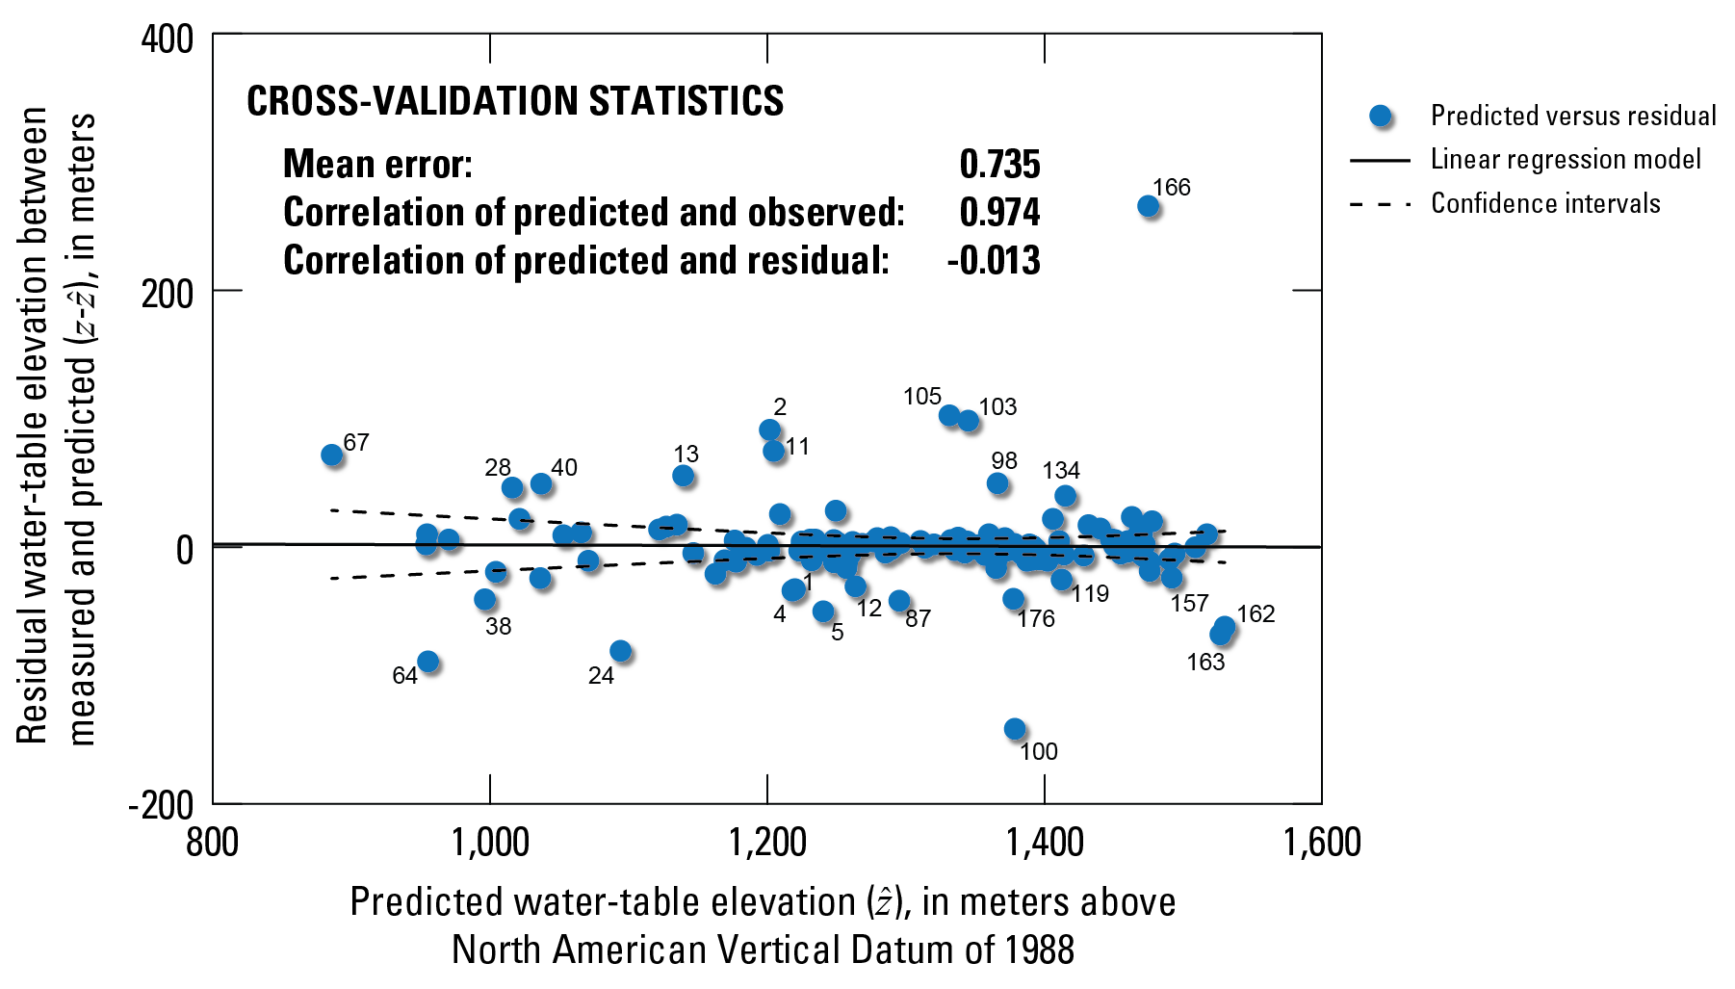
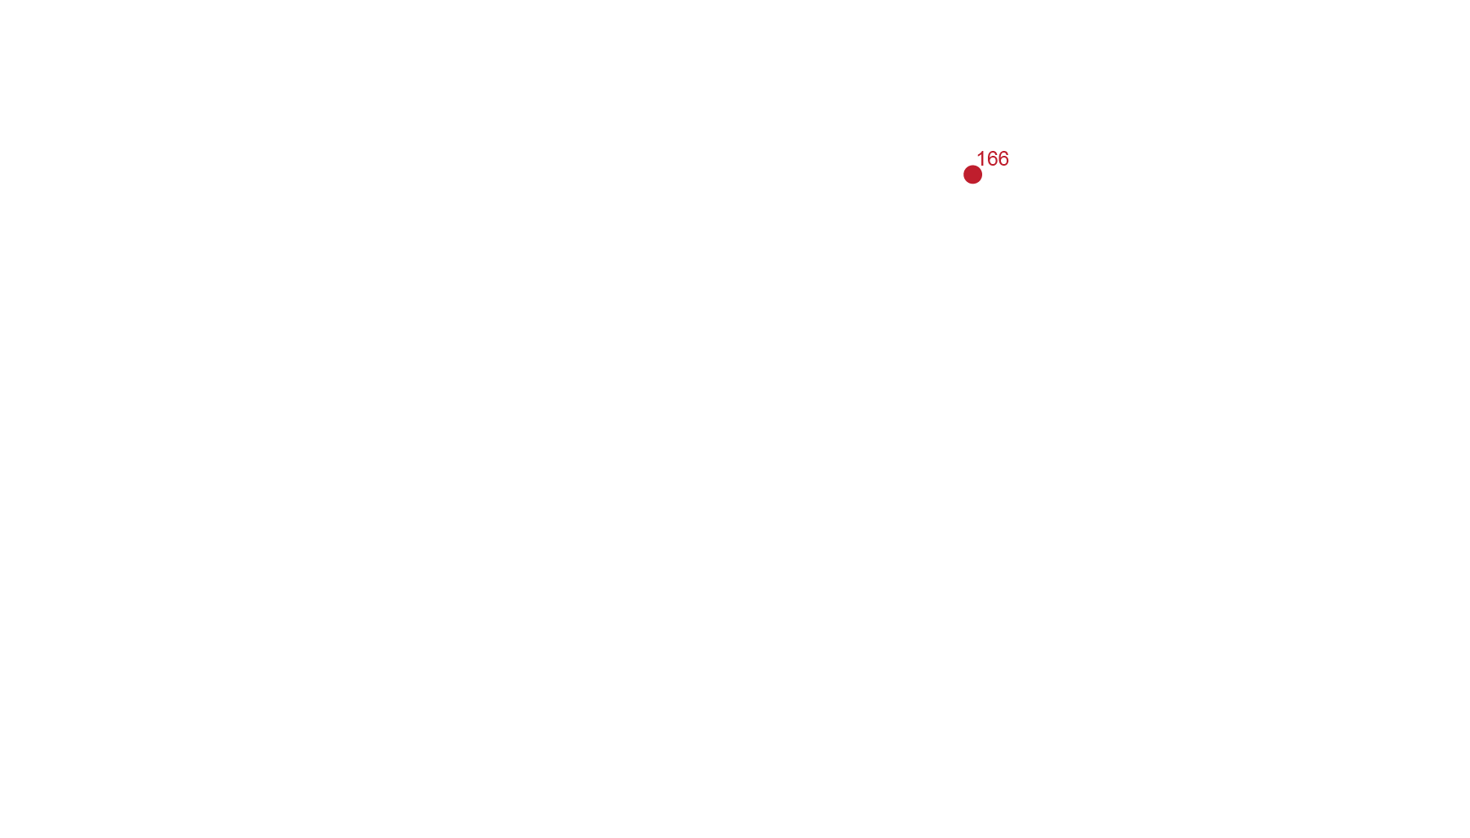
Notes:
Leave-one-out cross validation analysis

Slide 14
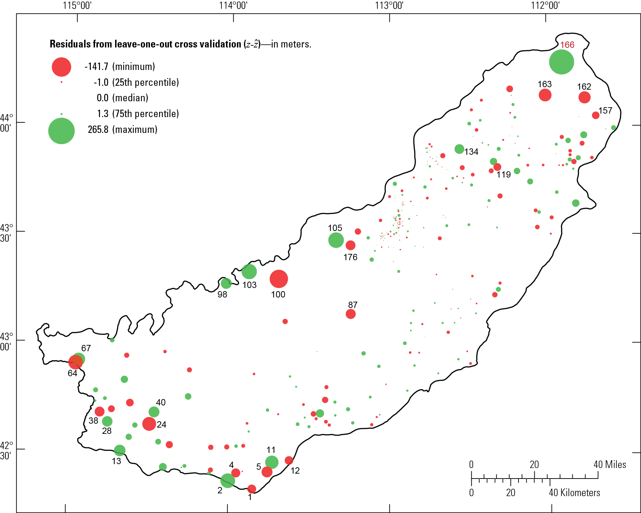

Slide 15
Kriging with an External Drift (KED)
A model for kriging water table elevations using topographic elevation from a digital elevation model (DEM) as an external drift function.
Key assumption
The water table is a subdued replica of the topology.

Slide 16
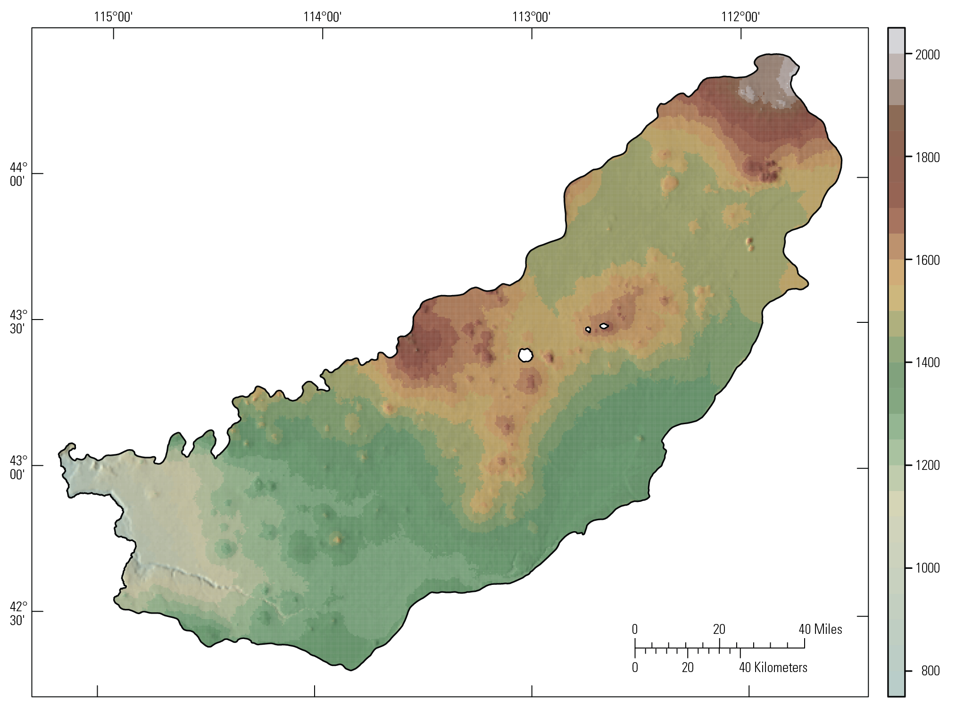
Land-surface elevation, in meters

Slide 17
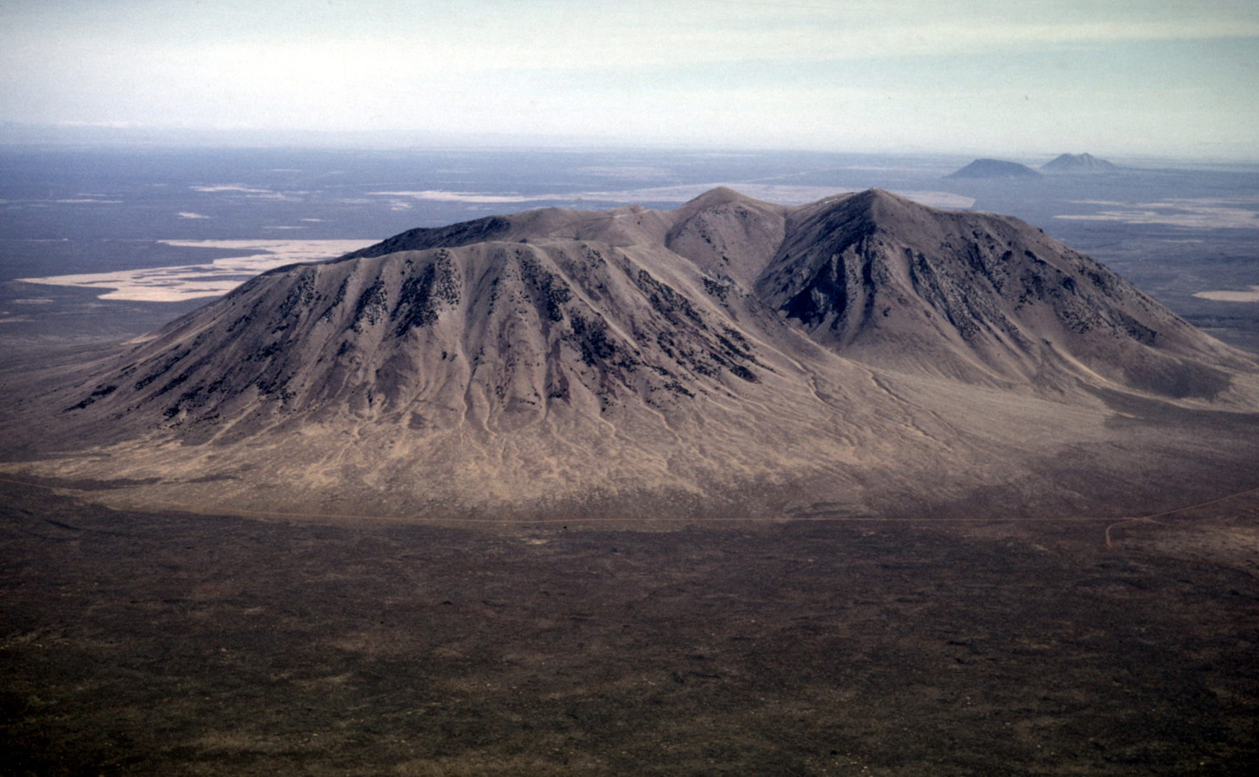
Big Southern Butte

Slide 18
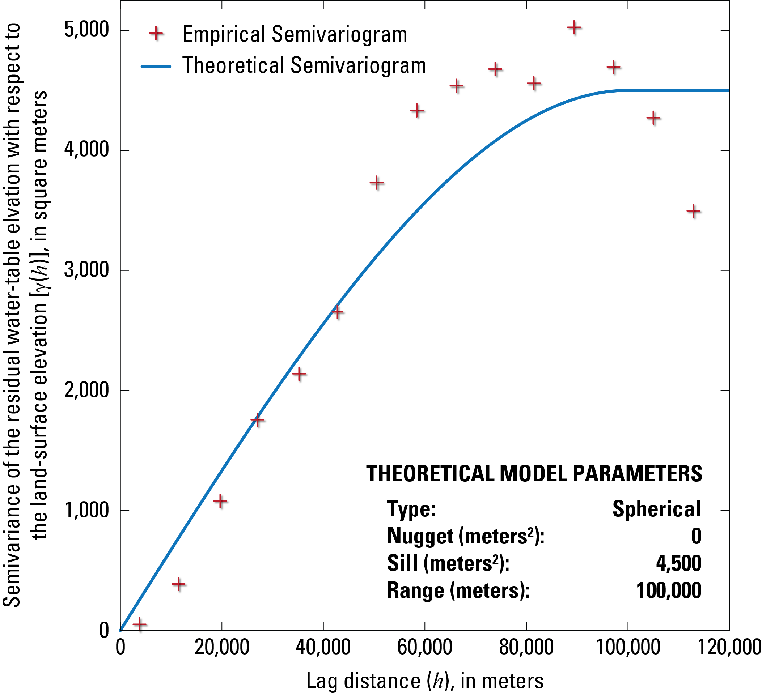

Slide 19
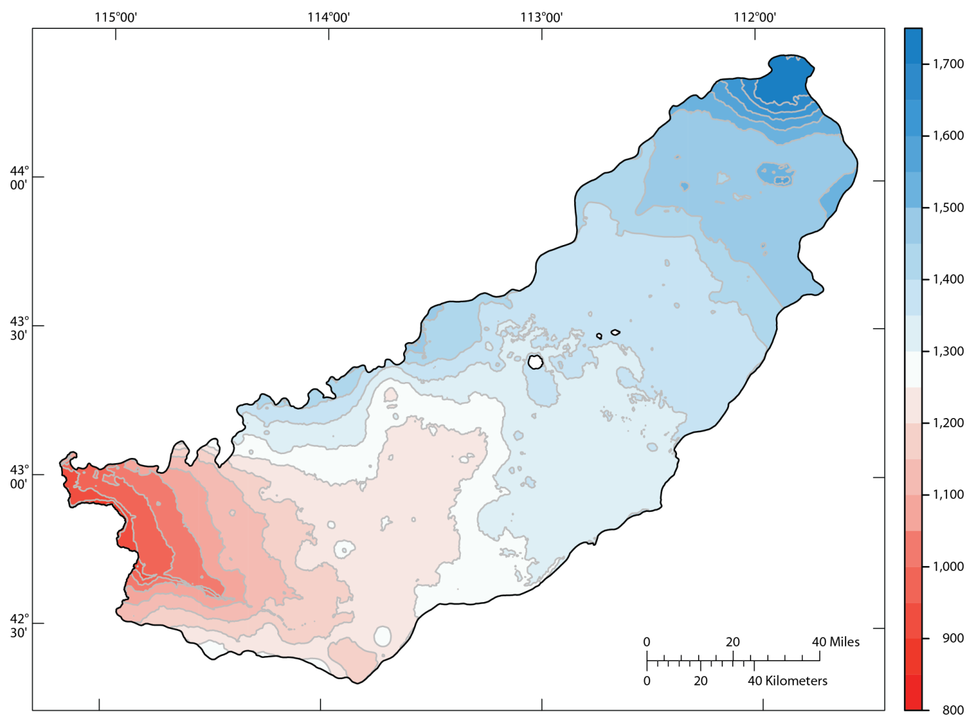
KED

Slide 20
UK

Slide 21
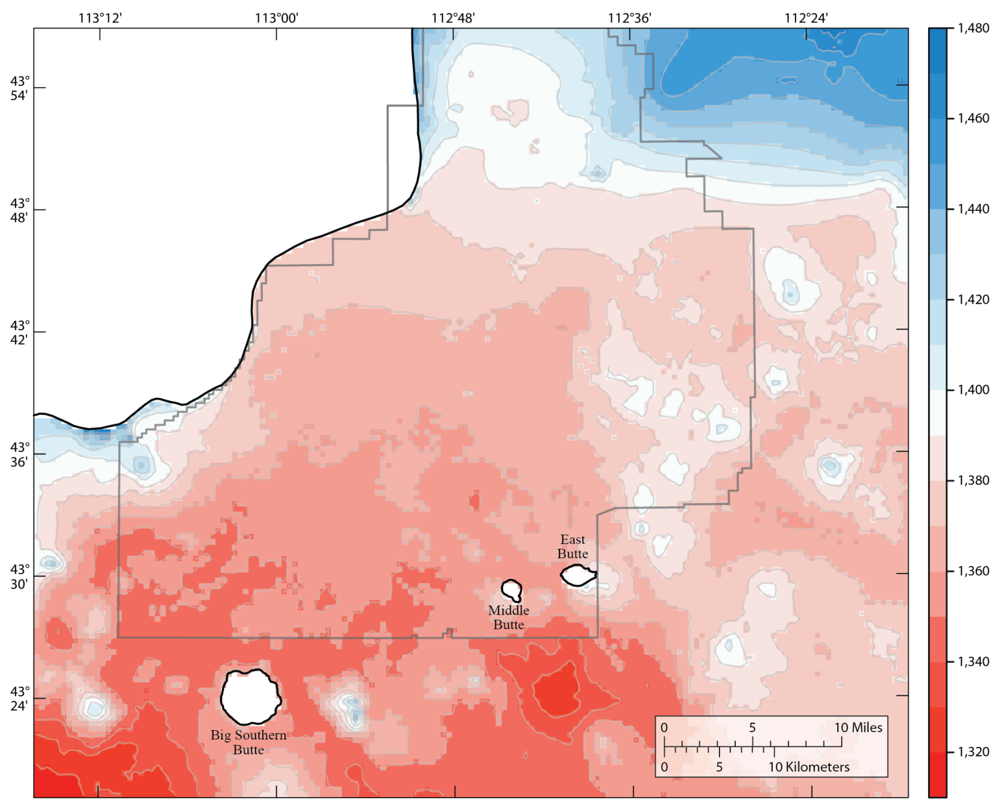
KED

Slide 22
UK

Slide 23
Planning objective for a water-table monitoring network
A reduction in the total monitoring cost by removing wells from an existing network because they provide little or no beneficial added information. Wells are evaluated exclusively through a geostatistical analysis of the water-table elevation measurements.

Slide 24
Design criteria:
The total number of wells in the optimized monitoring network is fixed and based on a user-defined number of wells to remove from the existing network.
Interpolation error from the application of kriging should be as small as possible.
Preserve local anomalies in the water-table distribution arising from unique water-level measurements that cannot be described (interpolated) by the rest of the measured values.
Preserve the variability of water-level measurements over time. Monitoring wells with hydrographs that exhibit prominent seasonal fluctuation and long-term changes are important for understanding the availability and sustainability of groundwater resources.
The measurement error of water-table elevations should be as small as possible.

Slide 25
Design criteria:
The total number of wells in the optimized monitoring network is fixed and based on a user-defined number of wells to remove from the existing network.
Interpolation error from the application of kriging should be as small as possible.
Preserve local anomalies in the water-table distribution arising from unique water-level measurements that cannot be described (interpolated) by the rest of the measured values.
Preserve the variability of water-level measurements over time. Monitoring wells with hydrographs that exhibit prominent seasonal fluctuation and long-term changes are important for understanding the availability and sustainability of groundwater resources.
The measurement error of water-table elevations should be as small as possible.

Slide 26
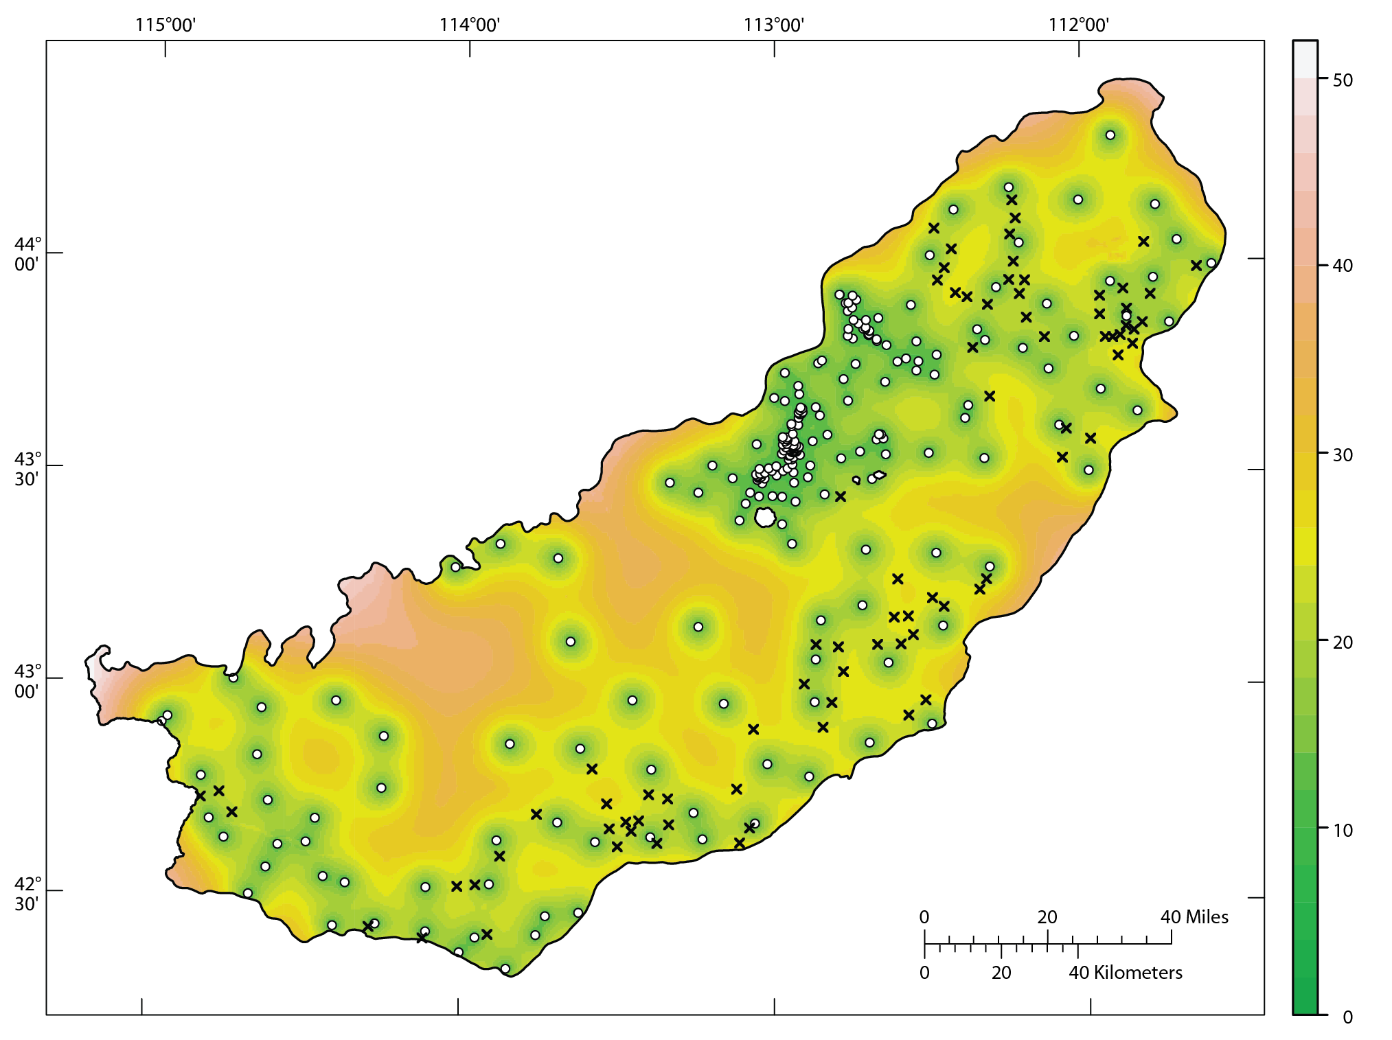
Standard error from the application of kriging, in meters

Slide 27
Design criteria:
The total number of wells in the optimized monitoring network is fixed and based on a user-defined number of wells to remove from the existing network.
Interpolation error from the application of kriging should be as small as possible.
Preserve local anomalies in the water-table distribution arising from unique water-level measurements that cannot be described (interpolated) by the rest of the measured values.
Preserve the variability of water-level measurements over time. Monitoring wells with hydrographs that exhibit prominent seasonal fluctuation and long-term changes are important for understanding the availability and sustainability of groundwater resources.
The measurement error of water-table elevations should be as small as possible.

Slide 28
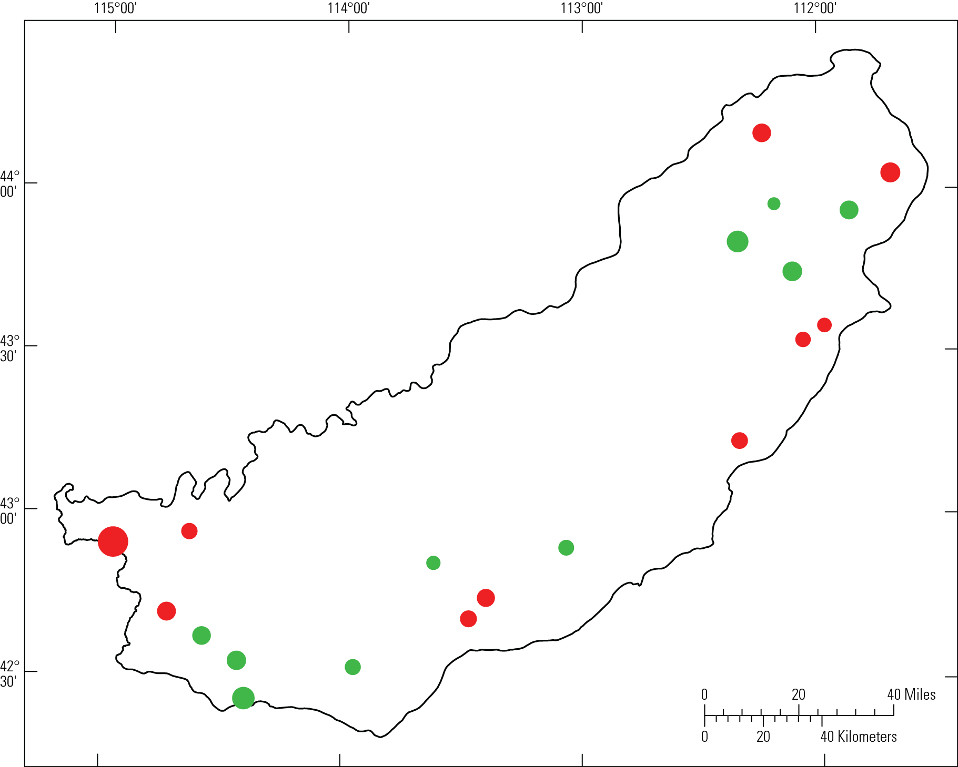
Residual error at removed sites, in meters

Slide 29
Design criteria:
The total number of wells in the optimized monitoring network is fixed and based on a user-defined number of wells to remove from the existing network.
Interpolation error from the application of kriging should be as small as possible.
Preserve local anomalies in the water-table distribution arising from unique water-level measurements that cannot be described (interpolated) by the rest of the measured values.
Preserve the variability of water-level measurements over time. Monitoring wells with hydrographs that exhibit prominent seasonal fluctuation and long-term changes are important for understanding the availability and sustainability of groundwater resources.
The measurement error of water-table elevations should be as small as possible.

Slide 30
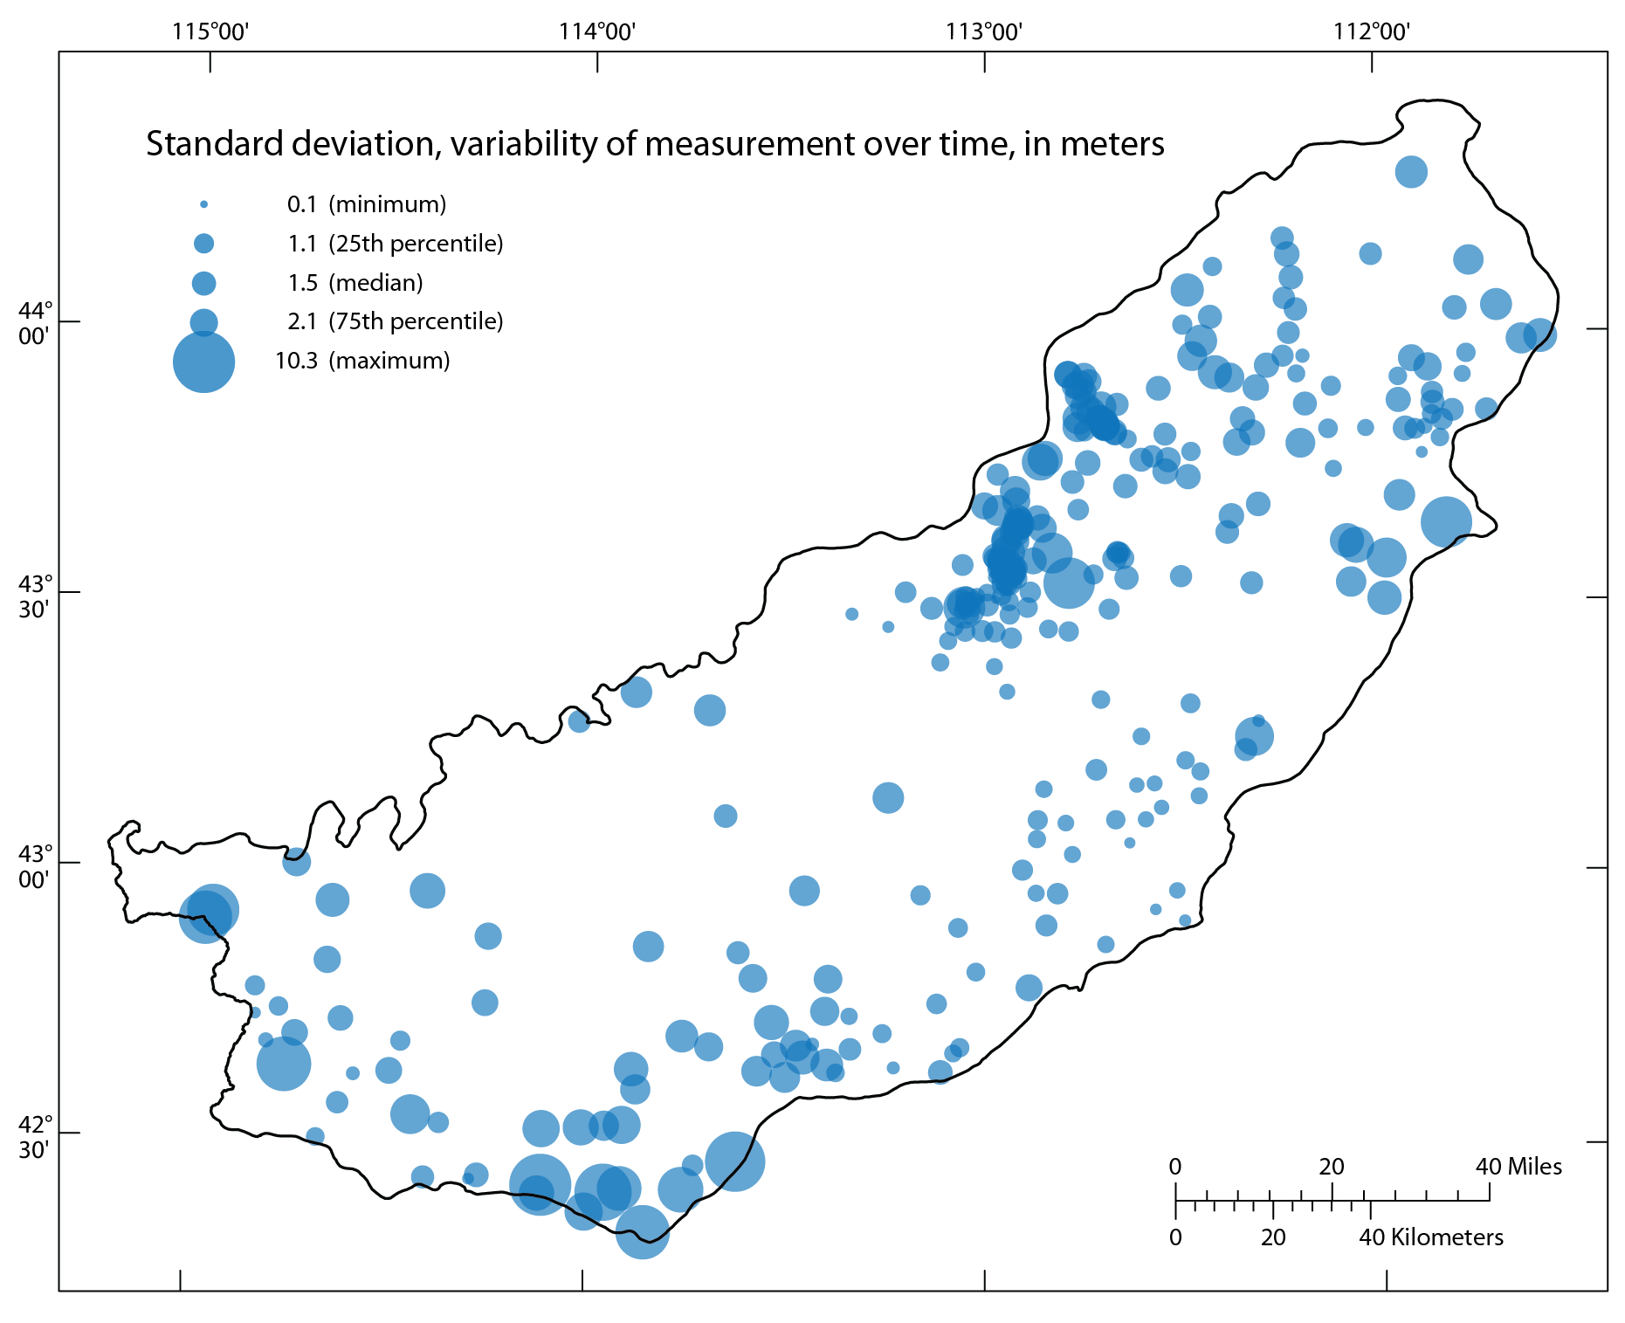

Slide 31
Design criteria:
The total number of wells in the optimized monitoring network is fixed and based on a user-defined number of wells to remove from the existing network.
Interpolation error from the application of kriging should be as small as possible.
Preserve local anomalies in the water-table distribution arising from unique water-level measurements that cannot be described (interpolated) by the rest of the measured values.
Preserve the variability of water-level measurements over time. Monitoring wells with hydrographs that exhibit prominent seasonal fluctuation and long-term changes are important for understanding the availability and sustainability of groundwater resources.
The measurement error of water-table elevations should be as small as possible.

Slide 32
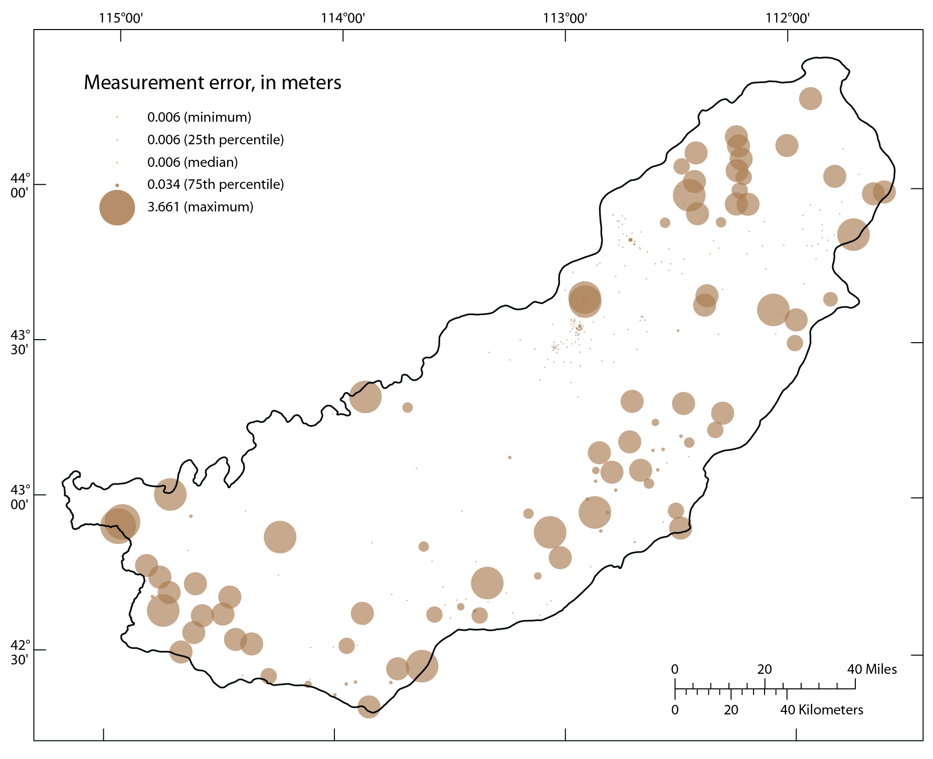

Slide 33
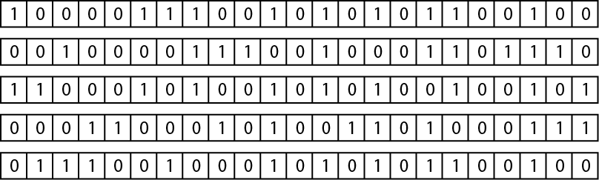
Genetic Algorithm (GA)
“The genetic algorithm is a highly parallel mathematical algorithm that transforms a set (population) of individual mathematical objects (typically fixed-length character strings patterned after chromosome strings), each with an associated fitness value, into a new population (i.e., the next generation) using operations patterned after the Darwinian principle of reproduction and survival of the fittest and after naturally occurring genetic operations (notably sexual recombination).” –Koza (1992)
Notes:
crossover

Slide 34
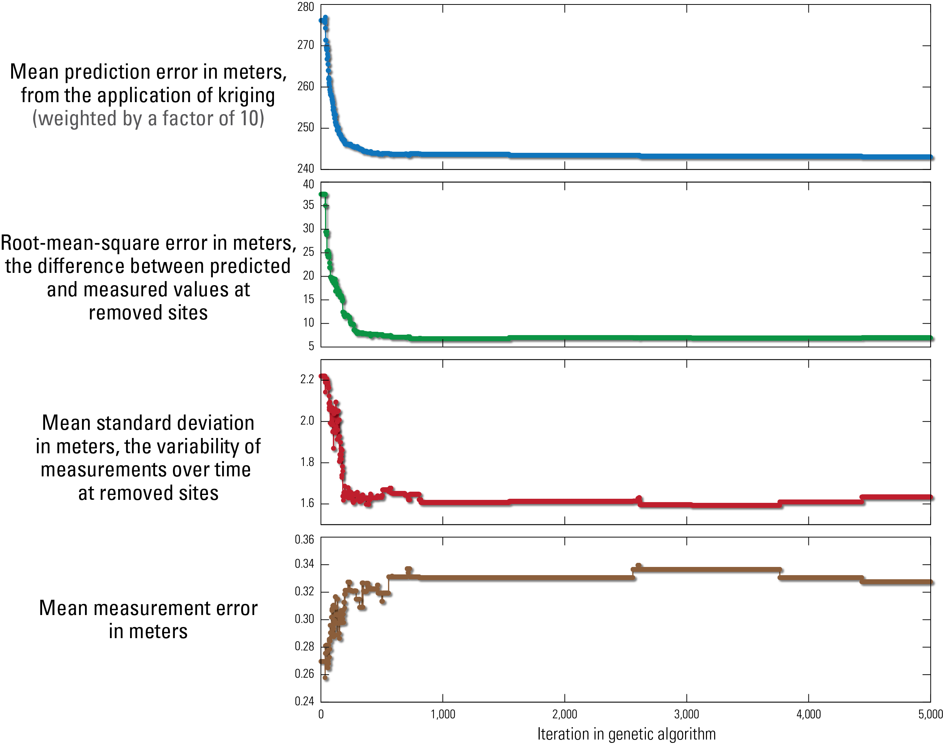

Slide 35
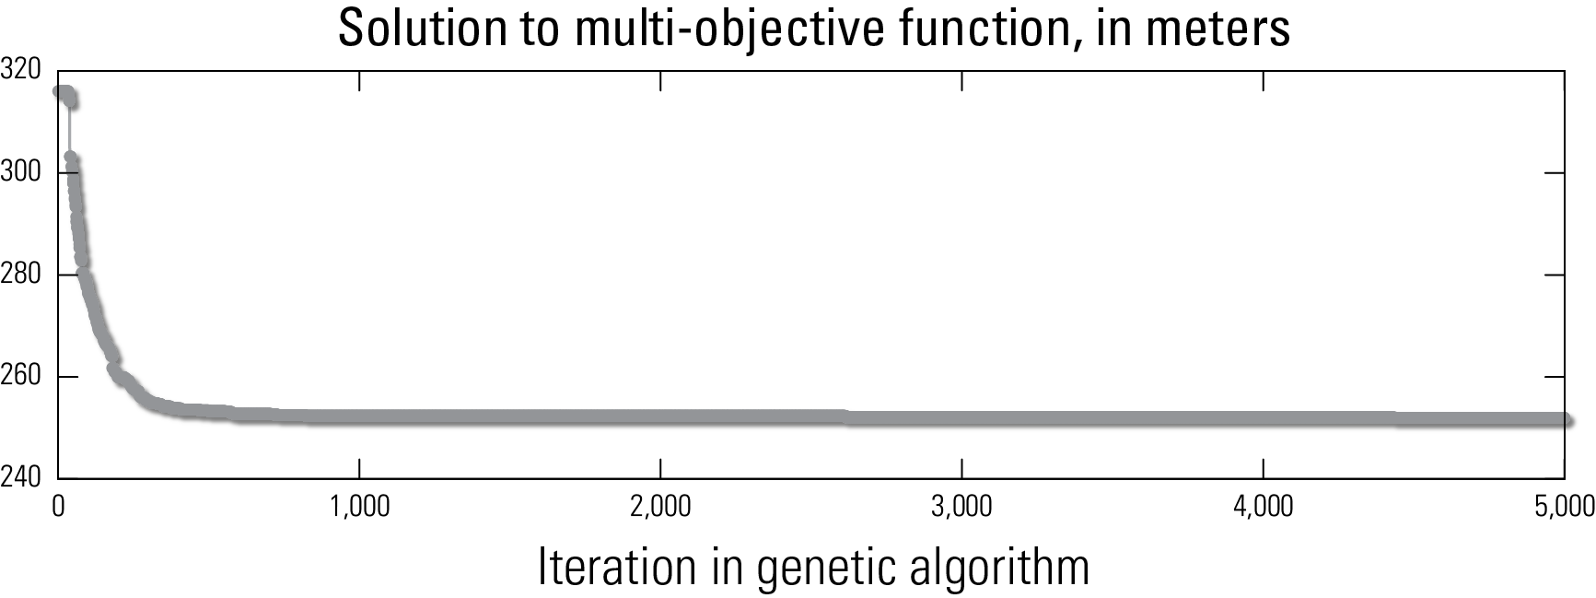

Slide 36
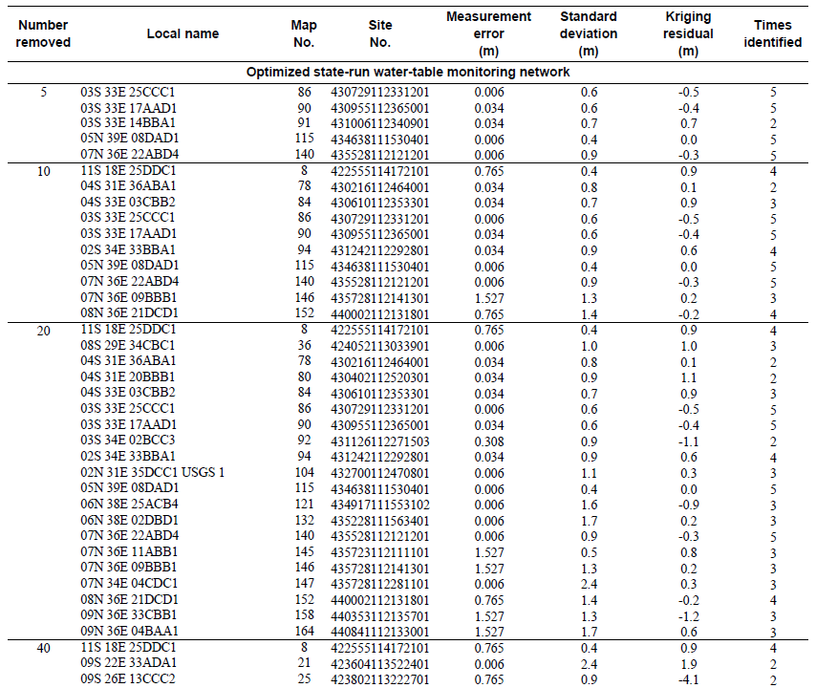

Slide 37
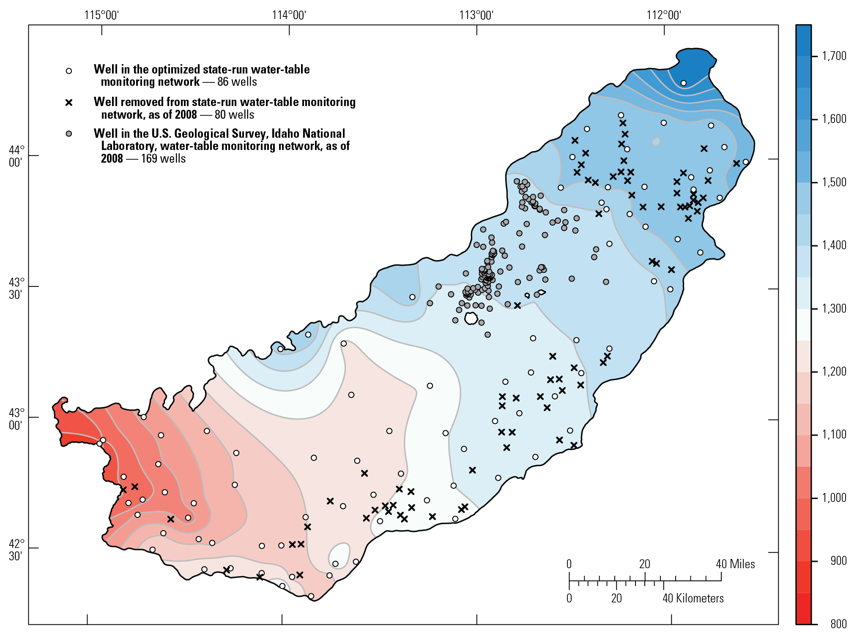

Slide 38
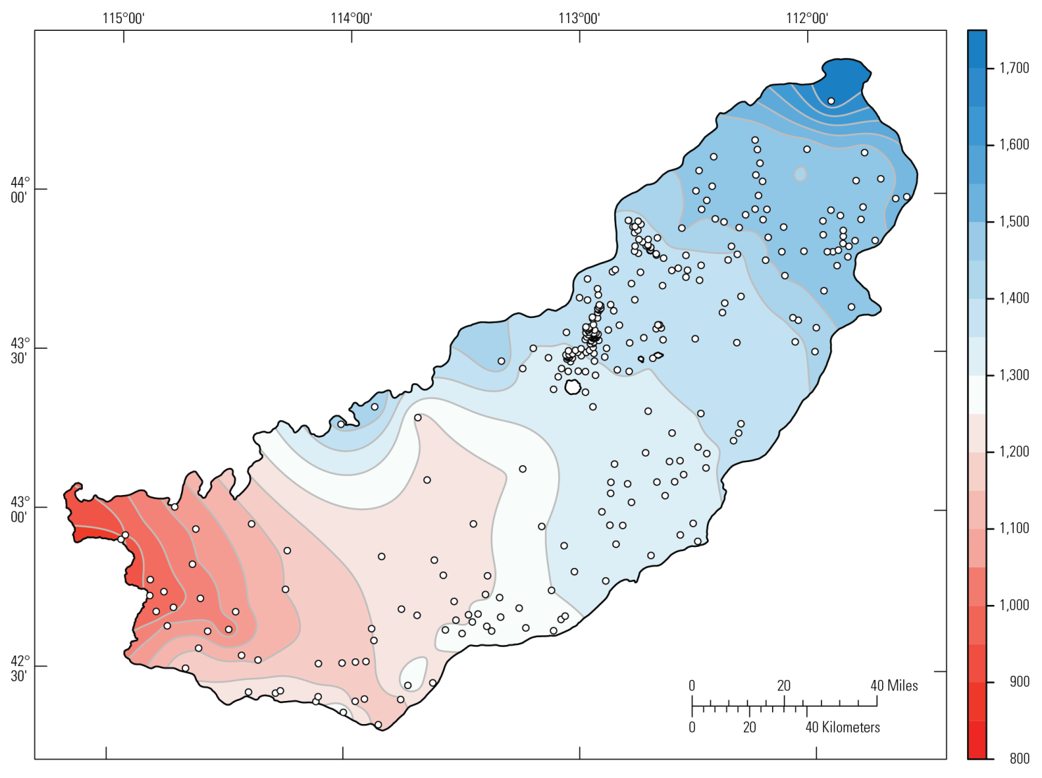

Slide 39
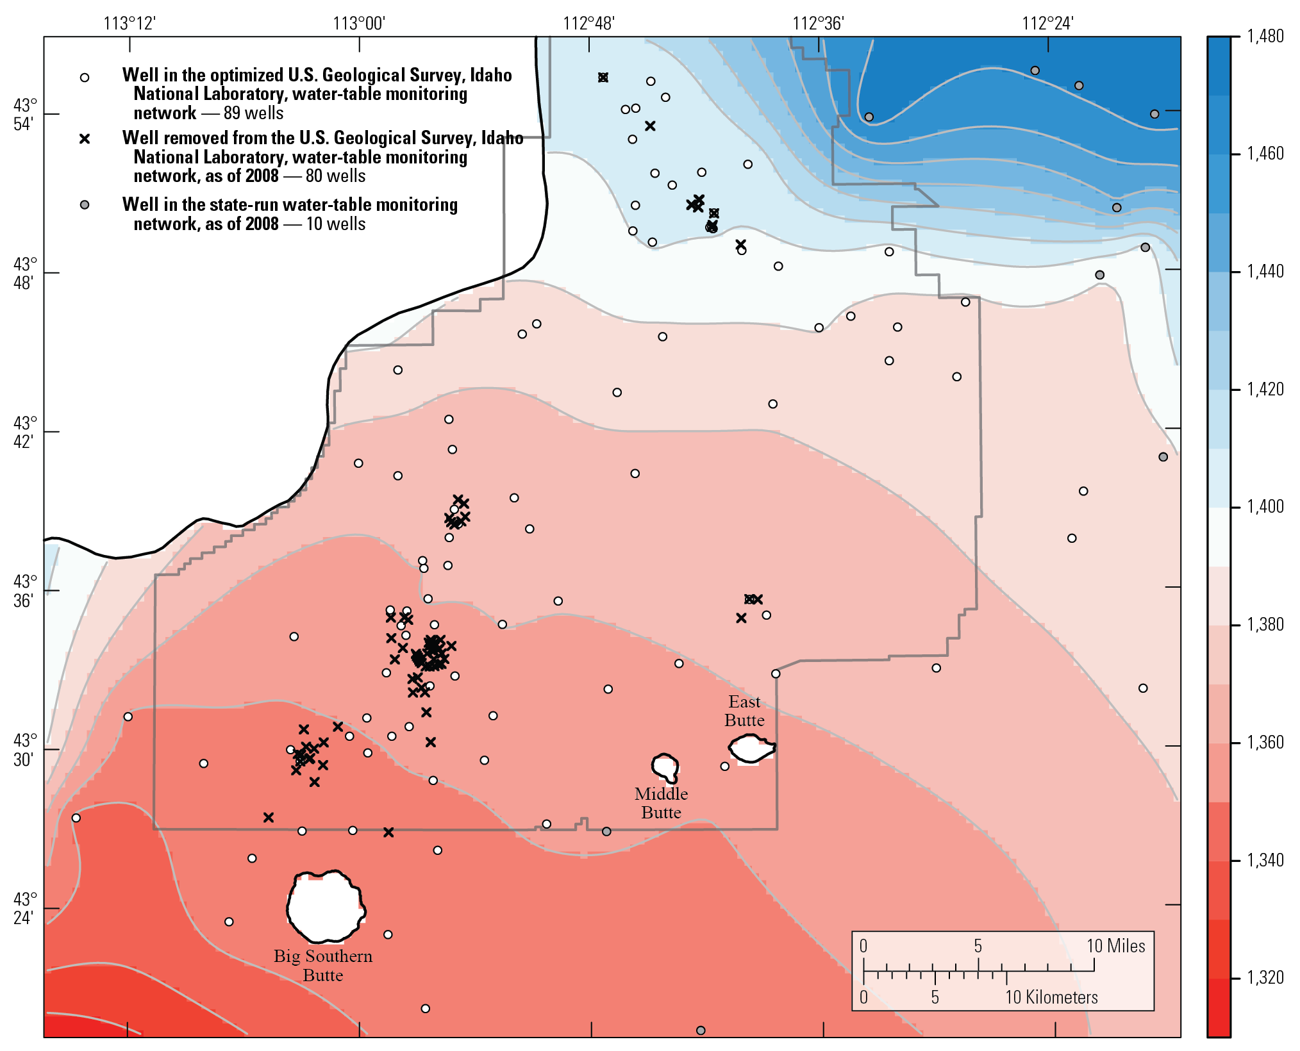

Slide 40
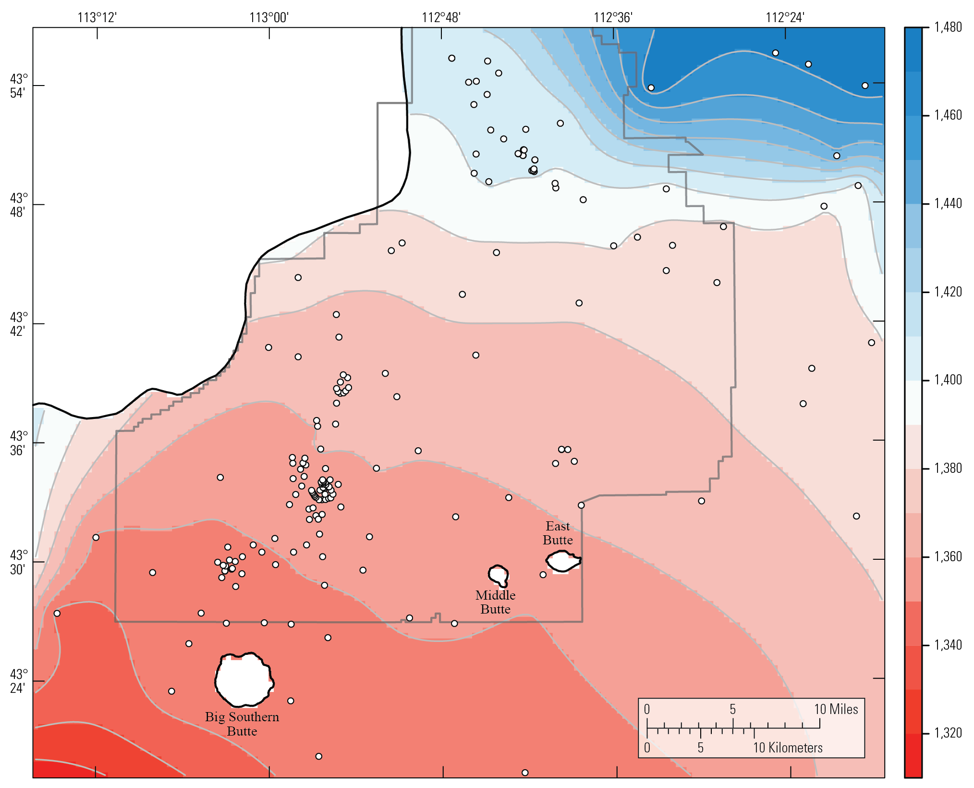

Slide 41
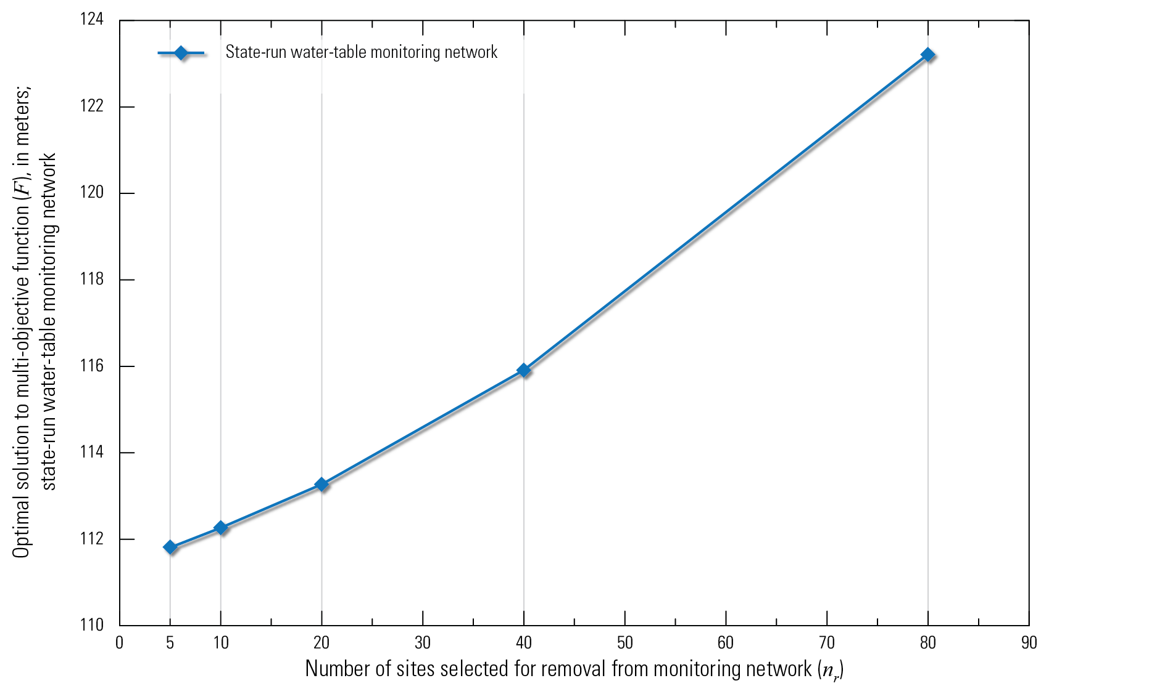
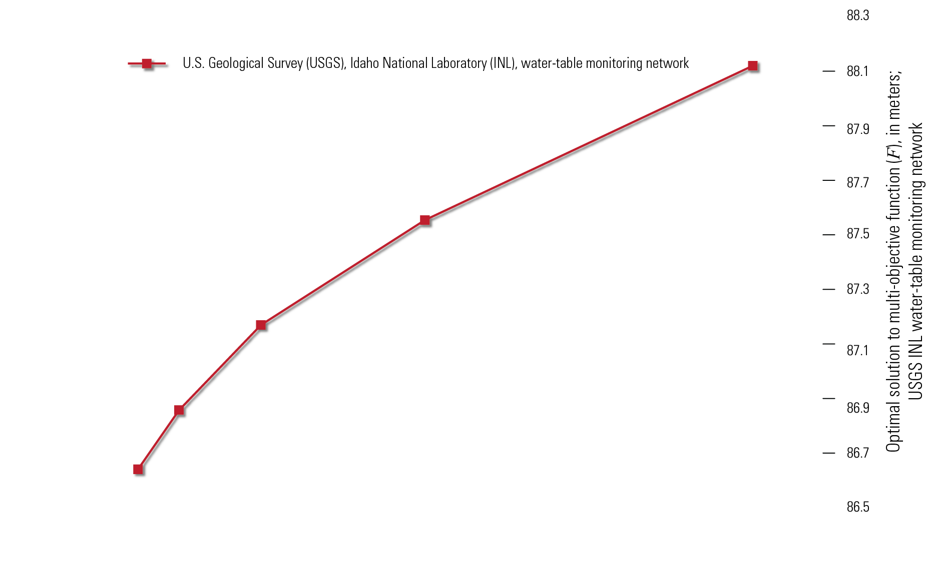

Slide 42

ObsNetwork
https://github.com/jfisher-usgs/ObsNetwork
http://www.r-project.org
sp
rgdal
raster
classes and methods for spatial data
geospatial data abstraction library
modeling with raster data
gstat
genalg
spatial geostatistical modeling
genetic
algorithm

Slide 43
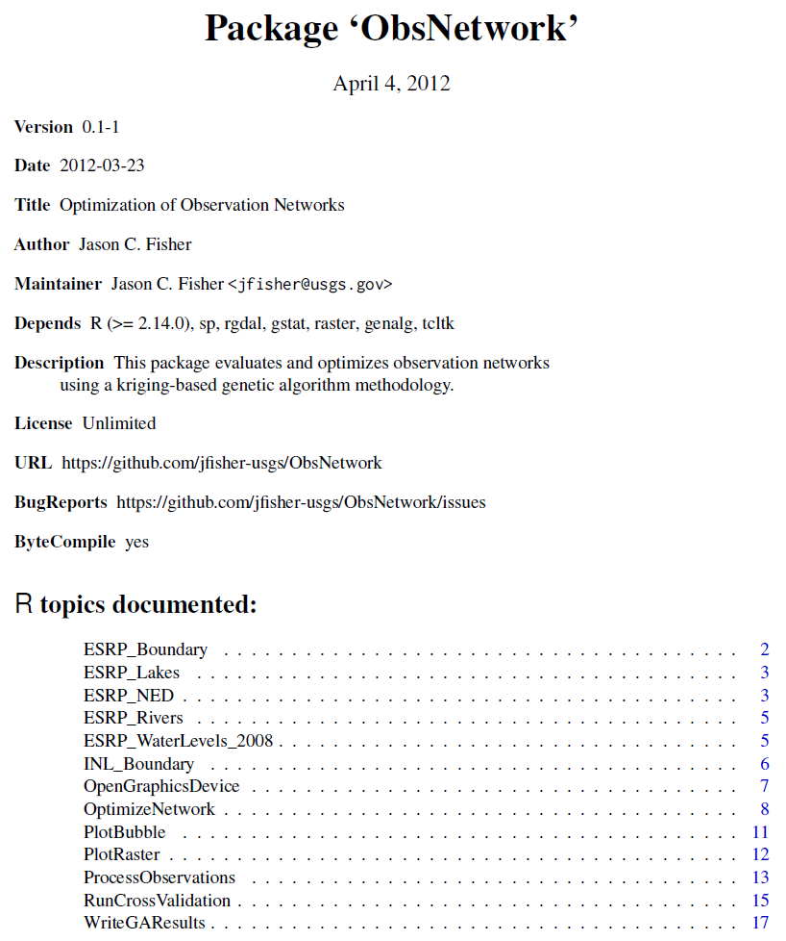

Slide 44



Slide 45


Slide 46


Slide 47

Reproducible Research

Slide 48


Slide 49

RNWIS

Slide 50


Slide 51


Slide 52


